Slide 1
Work Management Alpha: Service Assessment
Work Management Application
23 January 2024

Slide 2

Introduction and contents
Introduction and contents
Purpose of this document
The purpose of this document is to summarise the Alpha work we have undertaken and to present evidence of our work to conduct a Service Assessment for moving into Private Beta.
Intended audience
This document is intended to be shared with the service assessors and relevant stakeholders.
Understand users and their needs
Solve a whole problem for users
Provide a joined up experience across all channels
Make the service simple to use
Make sure everyone can use the service
Have a multidisciplinary team
Use agile ways of working
Iterated and improved frequently
Create a secure service which protects users’ privacy
Define what success looks like and publish performance data
Choose the right tools and technology
Make new source code open
Use and contribute to open standards, common components and patterns
Operate a reliable service

Slide 3
1. Understand users and their needs

Slide 4




In Alpha, we set out to solve the following user challenges identified during Discovery
These findings were prioritised at the end of Discovery and used to derive a set of high-level requirements and user stories
1
‘Sea of red’ hinders prioritisation
“Sometimes I can’t see the wood through the trees”
2
Inability to organise tasks in a meaningful way
“CMS manages me at times, rather than me managing my casework”
3
Multiple steps to get the right information
“When I need to find information quickly I can’t always rely on the CMS”
4
Offline tools used to help with planning and prioritisation
“People have got their own workarounds"

Slide 5
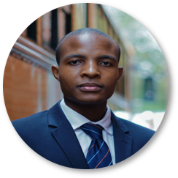



We engaged with a range of different end-users to help shape our new solution
The following personas were used to personalise the user experience according to a user’s job role and engagement with the case management system (CMS)
Casework assistant
"I assist prosecutors and legal teams with administrative tasks related to the progression of criminal cases. My responsibilities may include organising case files, coordinating court appearances, liaising with external parties, and providing general administrative support to ensure the smooth handling of casework. When using CMS sometimes I go into a case and have no idea what I’m meant to do.”
Paralegal assistant
"I assist paralegal officers and legal professionals in their day-to-day tasks. I may assist with case documentation, legal research, administrative duties, and provide general support to help maintain an efficient and organised legal workflow. My main challenge with CMS is juggling everything."
Prosecutor
"I'm a qualified legal professional responsible for handling criminal cases. My primary role involves reviewing evidence, assessing the merits of a case, and making decisions on whether to pursue charges against an individual or entity. With CMS I find it hard to see the wood from the trees when I have a page full of red tasks on my task list screen."
Paralegal officer
"I assist prosecutors and legal teams in various administrative and legal tasks.
My role may involve organising case files, conducting research, preparing legal documents, and providing general assistance to ensure the smooth functioning of the legal process. I find CMS manages me, more than me managing my case work."

Slide 6
We worked closely with them to identify how we could solve their challenges
We ran a series of one-to-one moderated user testing sessions to gather feedback on the UX designs. The input was used to ensure what was developed delivered on users’ needs.
1
"I want to see useful information when determining task priority, so that I can quickly identify my priorities in the task list"
"I want to see all assigned tasks and directions I need to complete in one view"
"I want to be able to identify and exclude from my task list tasks that are waiting on others to action not to appear on my Task list"
"I want error tasks not appear on my task list to be able to identify and exclude from my tasks that I cannot do anything about."
"I want to be able to organise my task view, so that I can have a view that is relevant to me."
"I want my task view filters and sort to persist, so that I don't need to reset them every time I log in"
"I want to be able to find a case on my task list and find associated tasks related to it."
"I want the system to take me from the task list directly to the case details view on CMS"
"I want to be able to perform quick actions within a task list, so that I can progress and manage my work more efficiently."
Additional use case scenarios only available in Work Management App
"I can view a calendar which shows me what due dates are approaching in the next month"
"I can set an alert, to notify me to action a task at an allocated time."
"I can create filter sets to save my filter requirements"
2
3
4
5
6
7
8
9
1
2
3

Slide 7
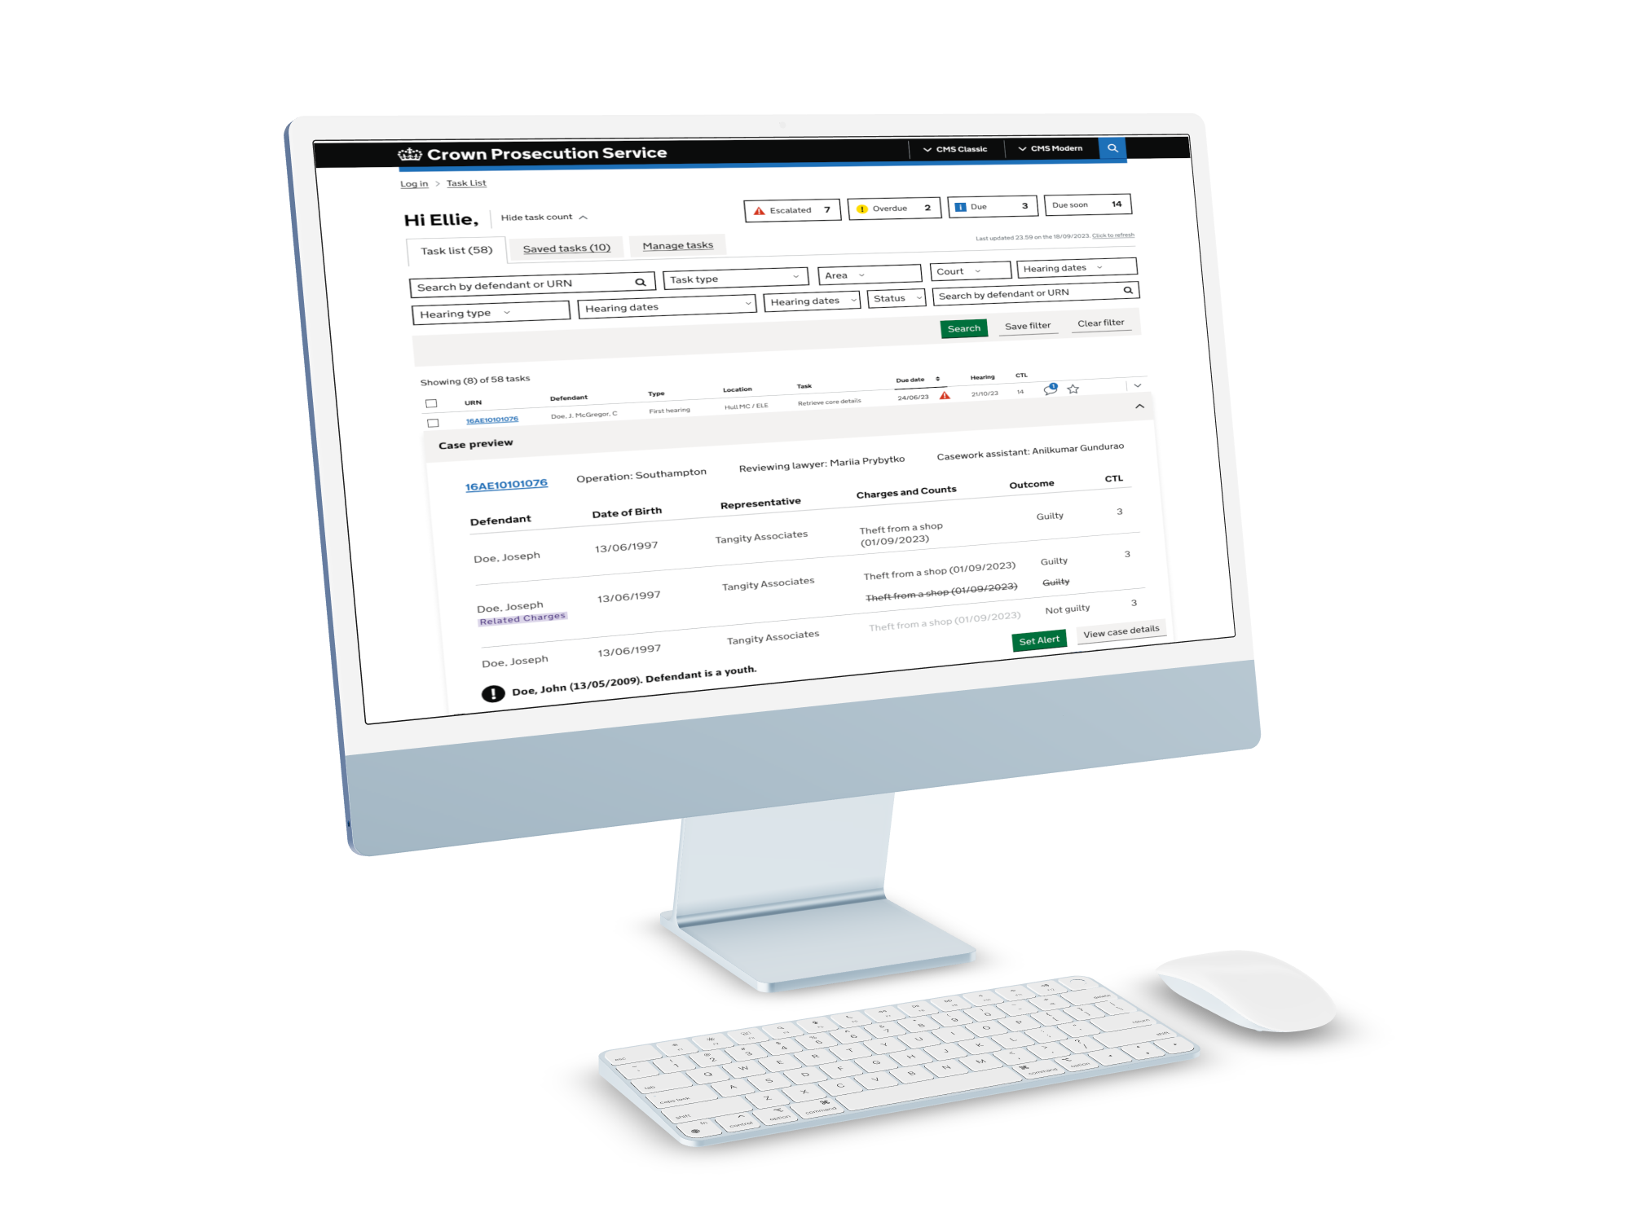
To tackle these user problems, we developed the Work Management Application
The Work Management Application introduces improvements to the way users view, prioritise and manage their tasks
Designed for casework assistants, paralegal officers, paralegal assistants and prosecutors, the Work Management Application will allow users to view, prioritise and manage their tasks in order to help progress a CPS case.
Unlike its legacy CMS Classic and Modern, the Work Management Application makes it easier to navigate, filter and manage tasks with additional features such as being able to preview case details, create a list of saved tasks, set alerts, and customise a personal calendar.
"Very easy to sort and navigate. And I'm quite impressed."
"I like it. It looks quite straightforward"
"It's quite easy to navigate. Quite a lot of information. There's a few additions compared to what we currently have."

Slide 8
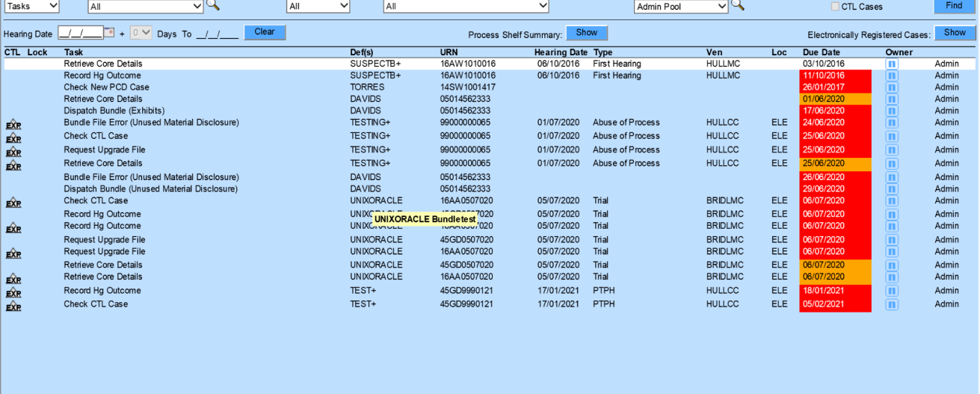
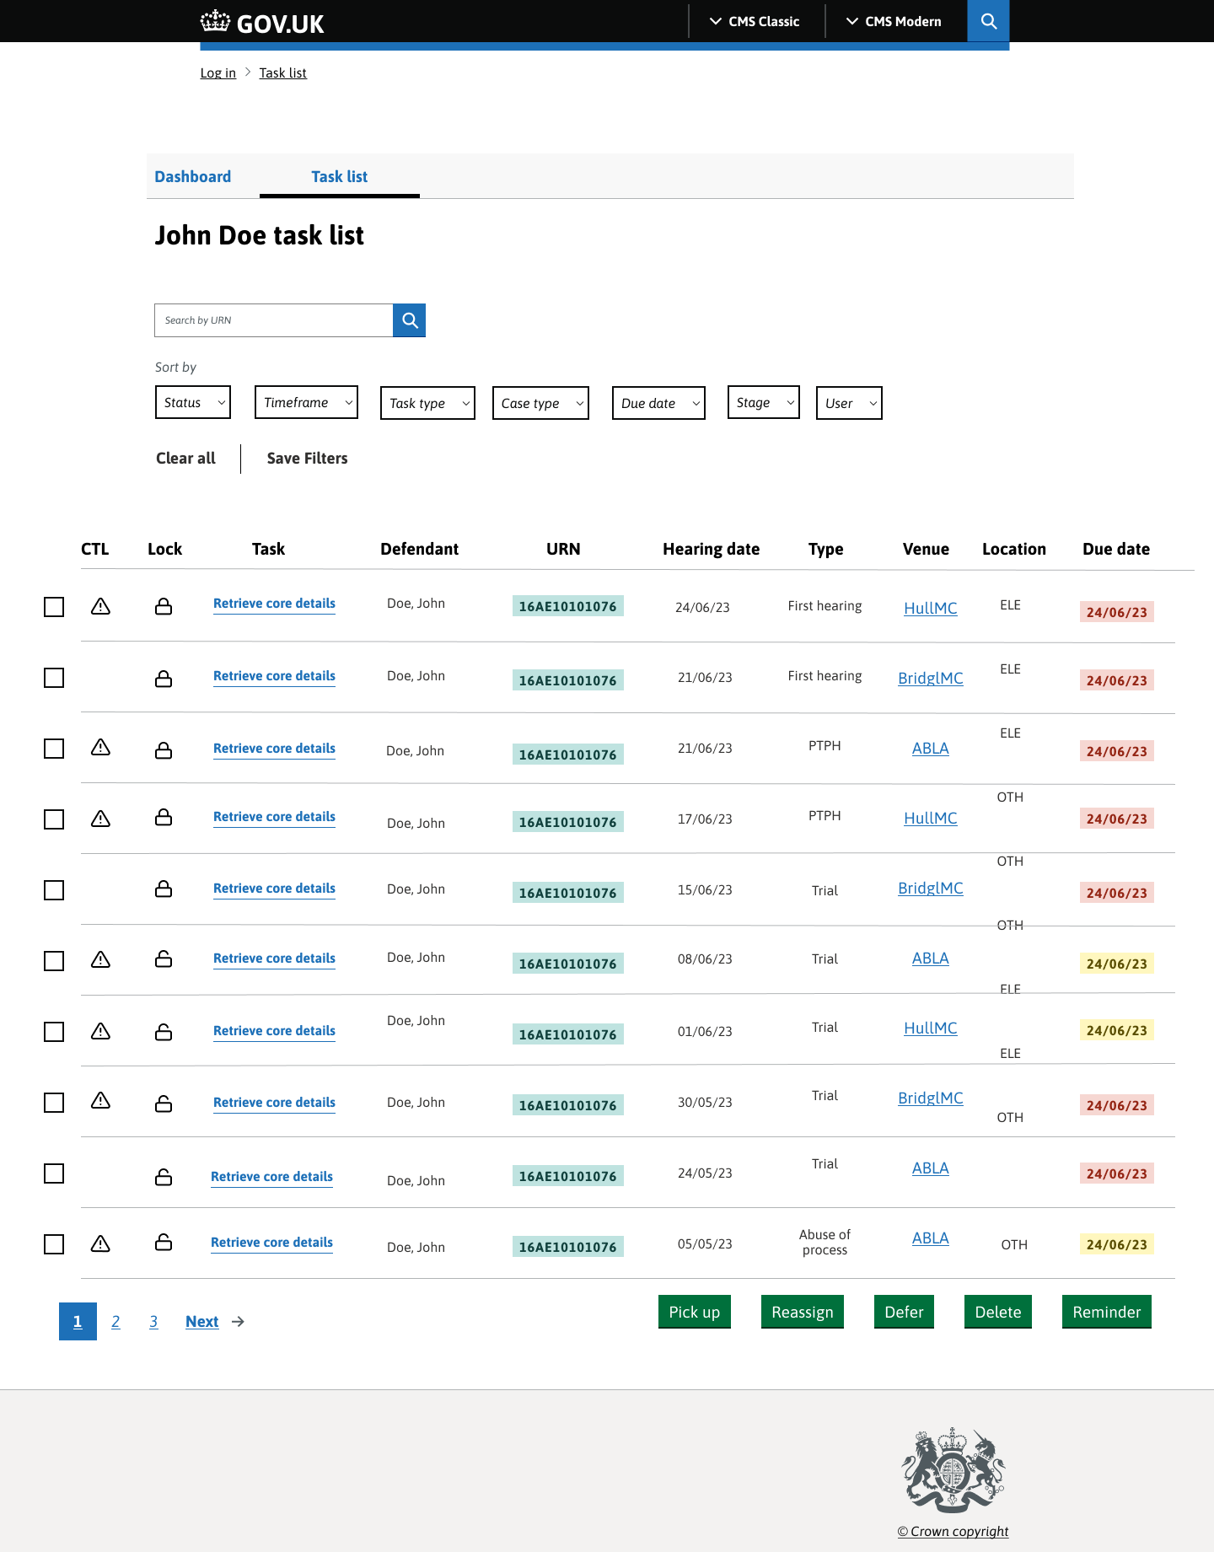
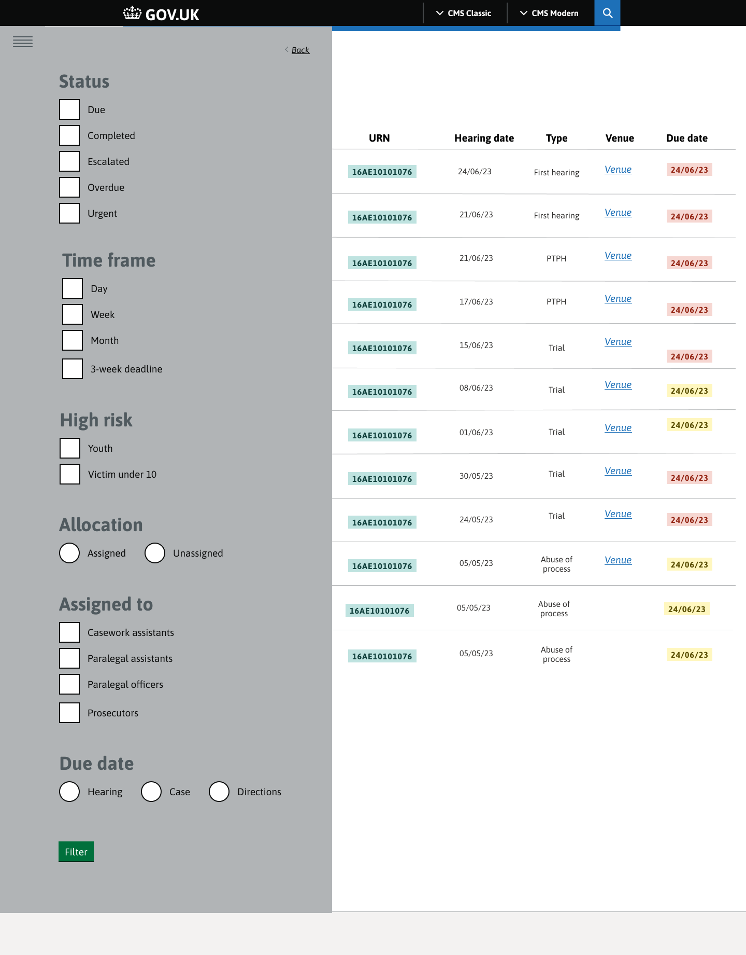
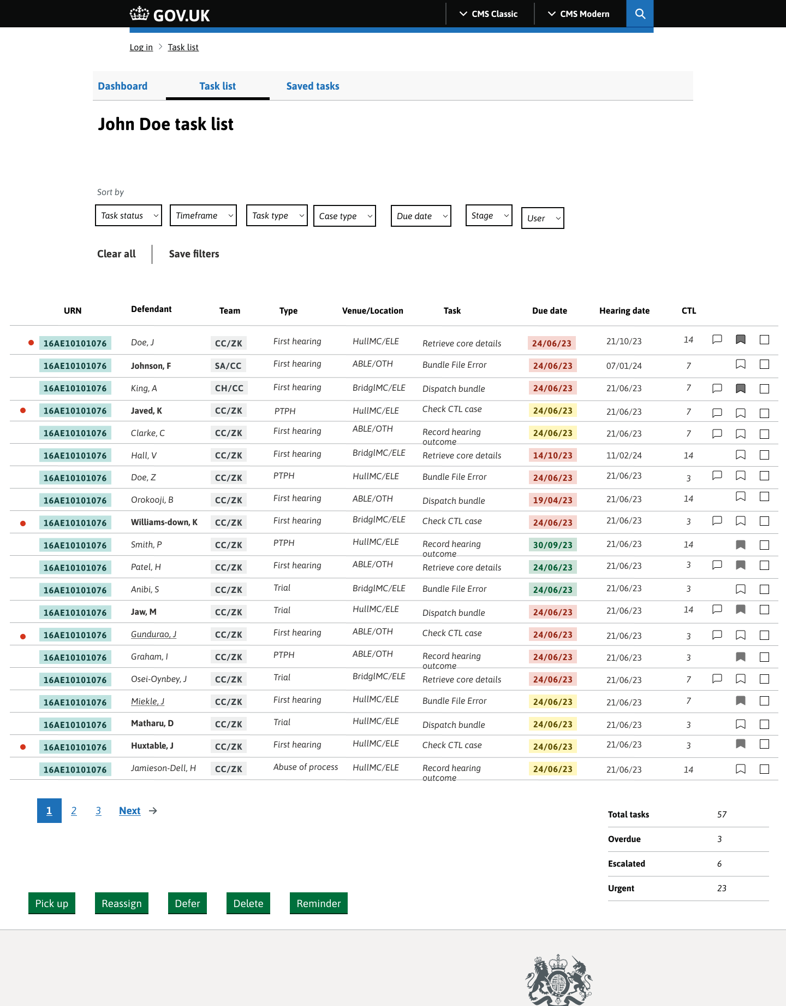
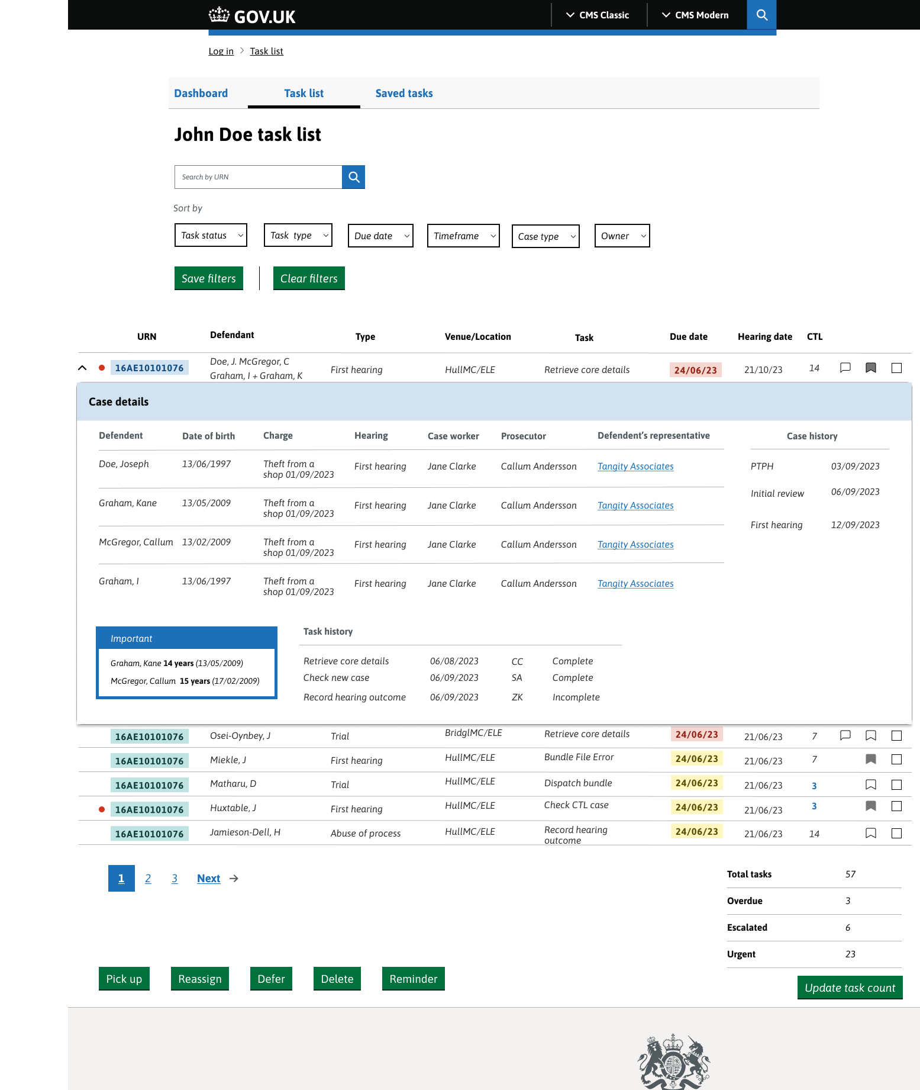
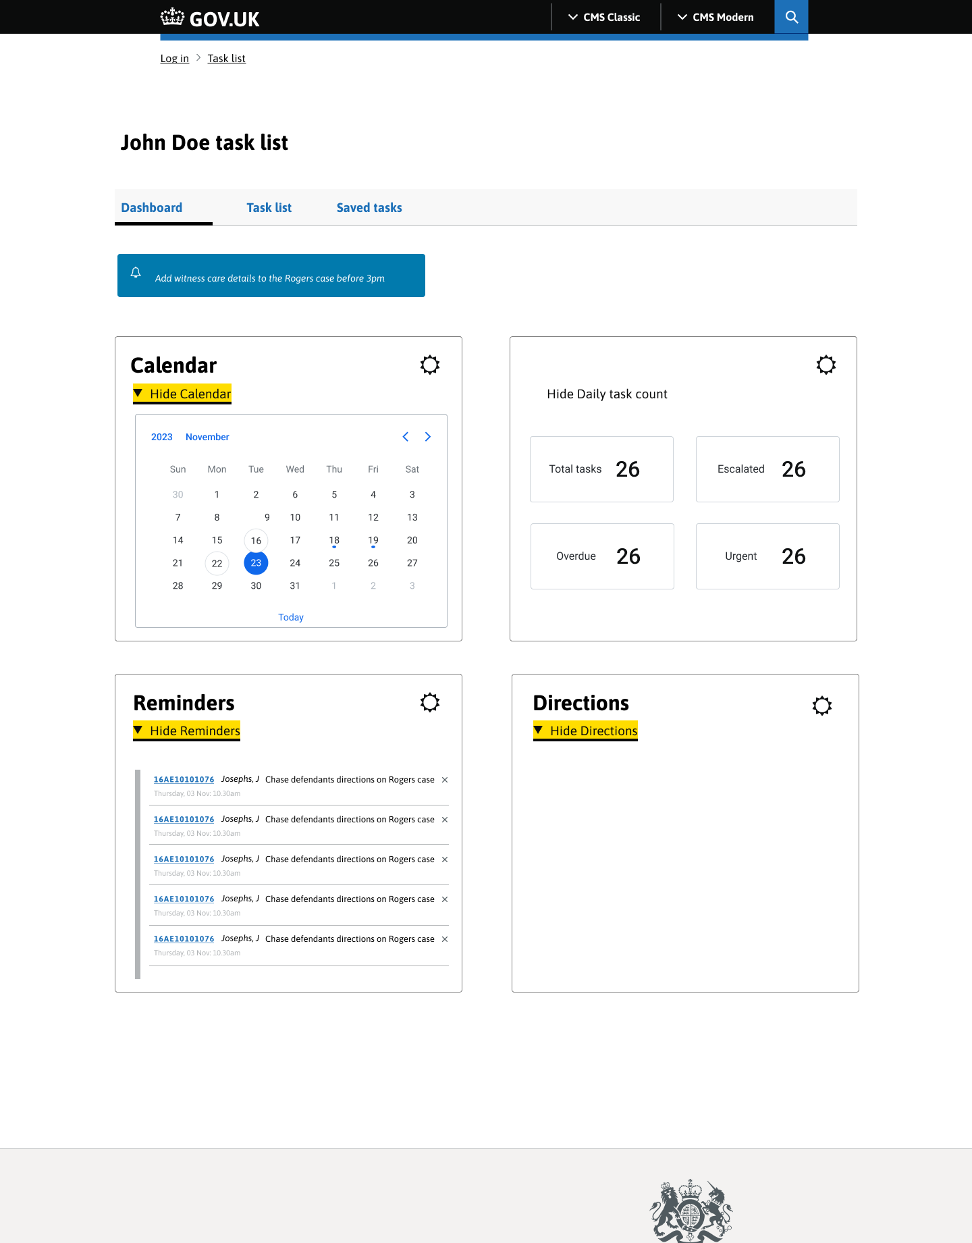
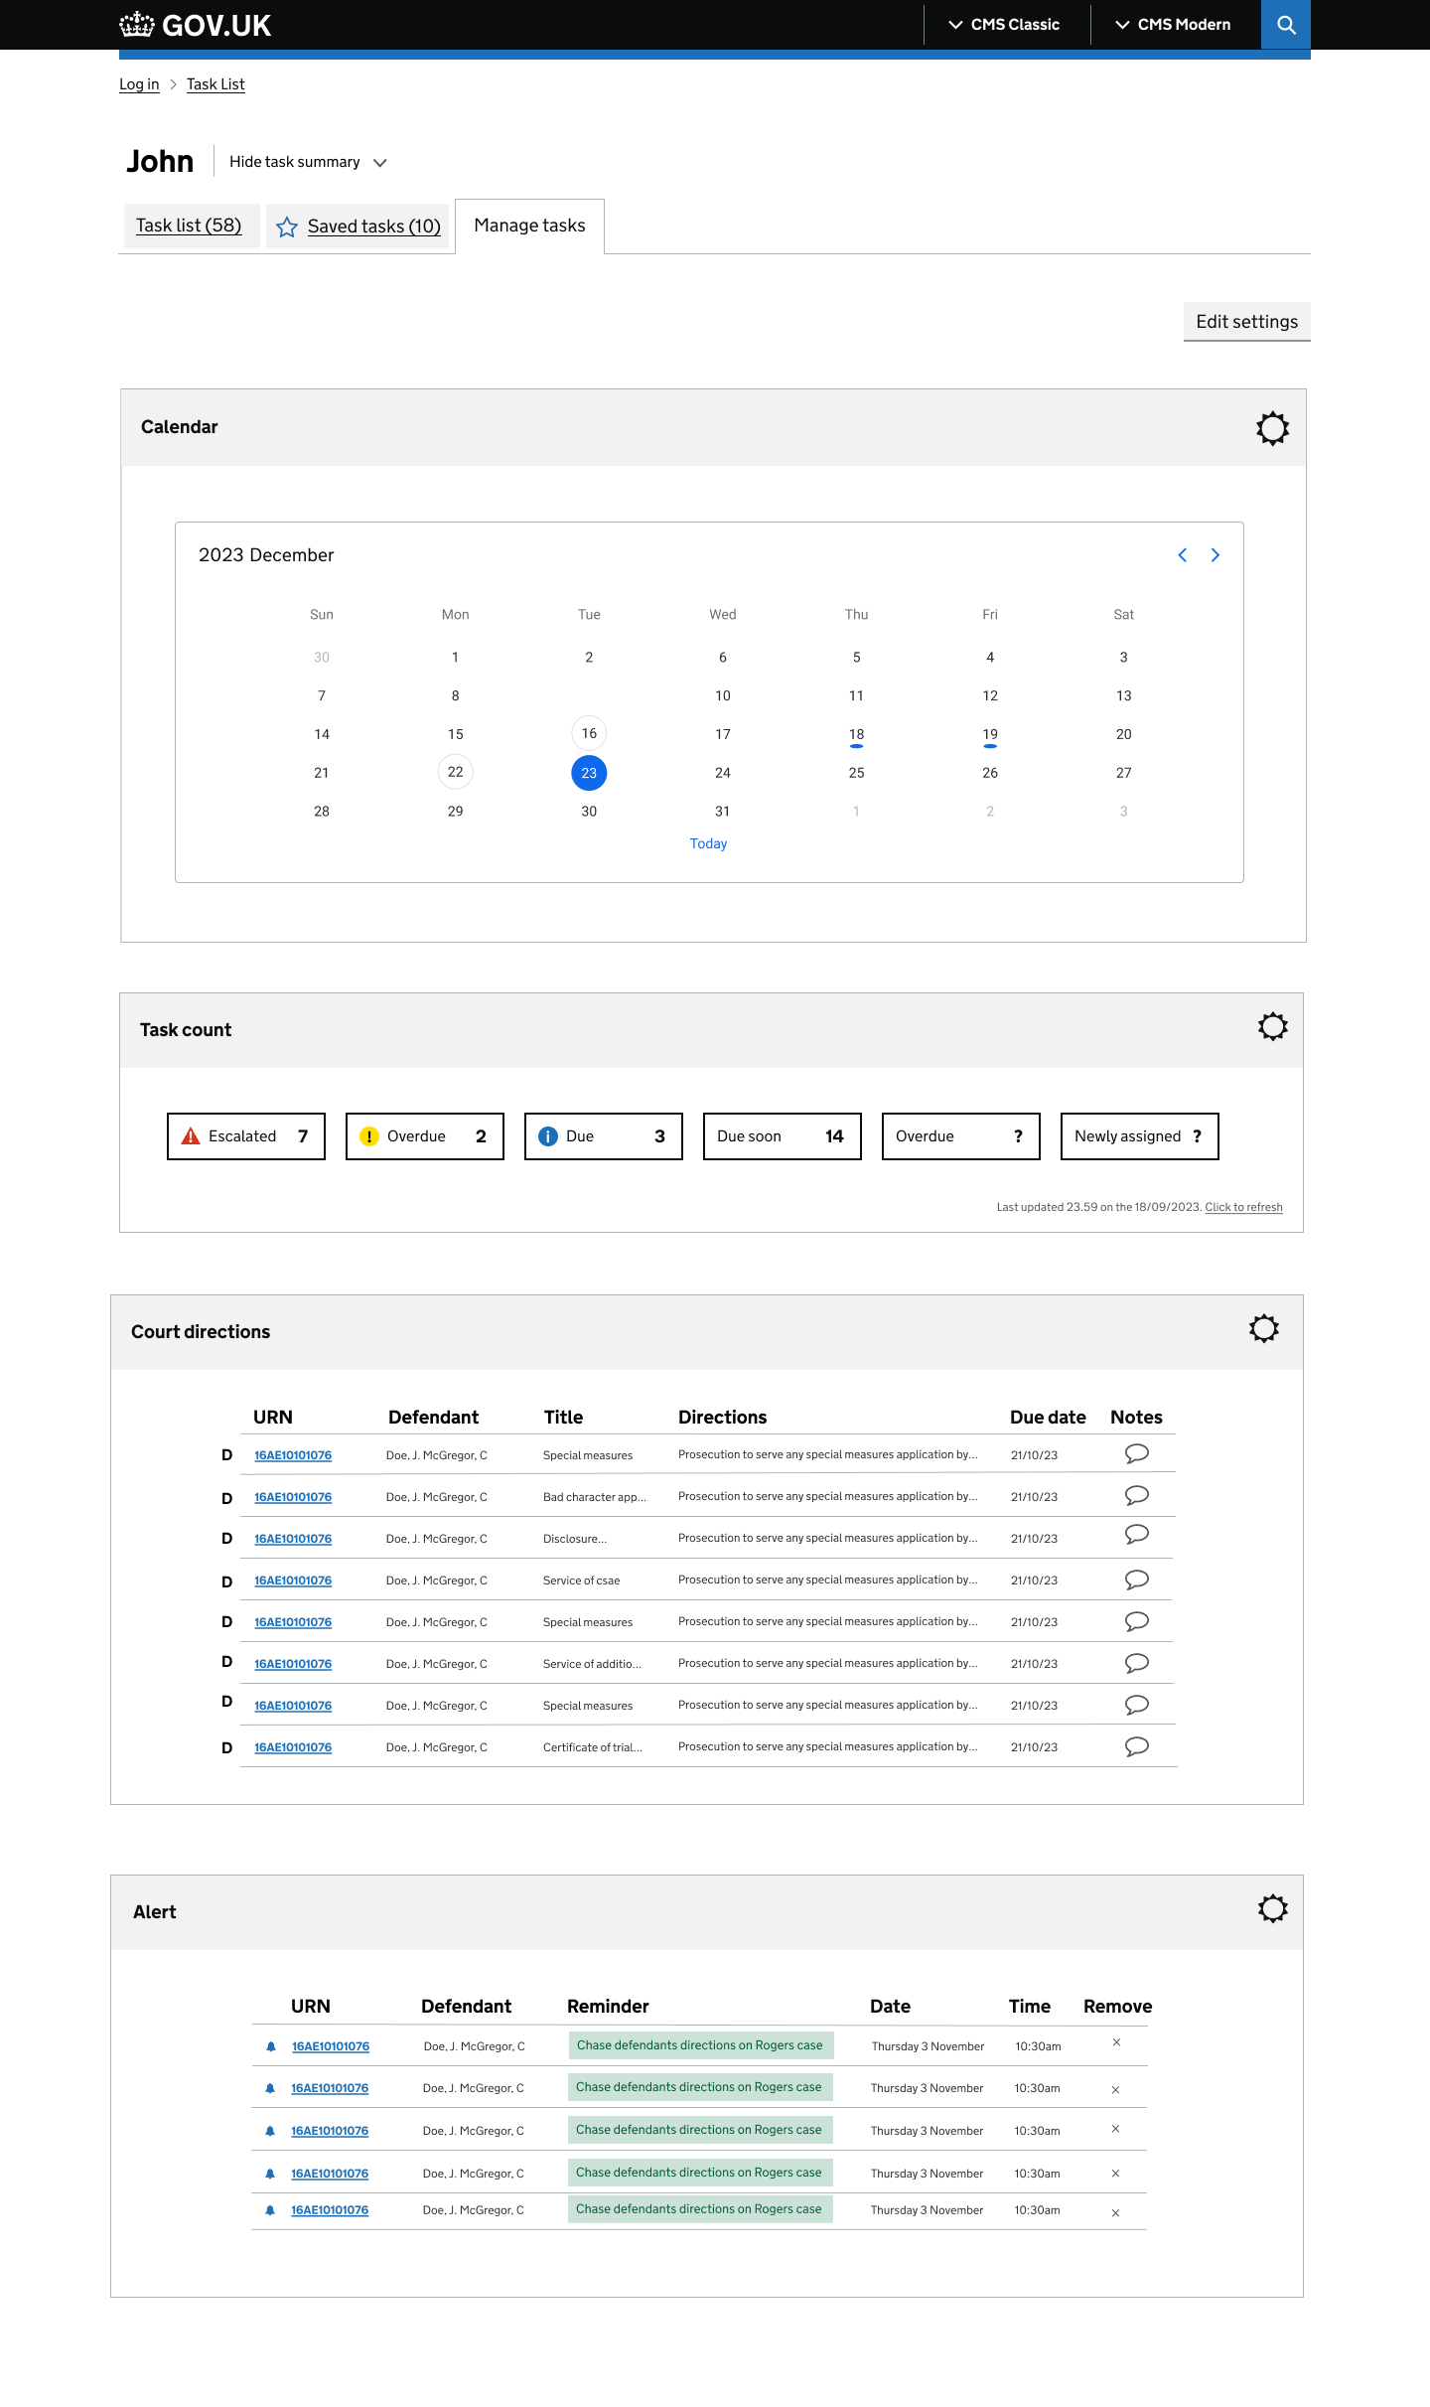
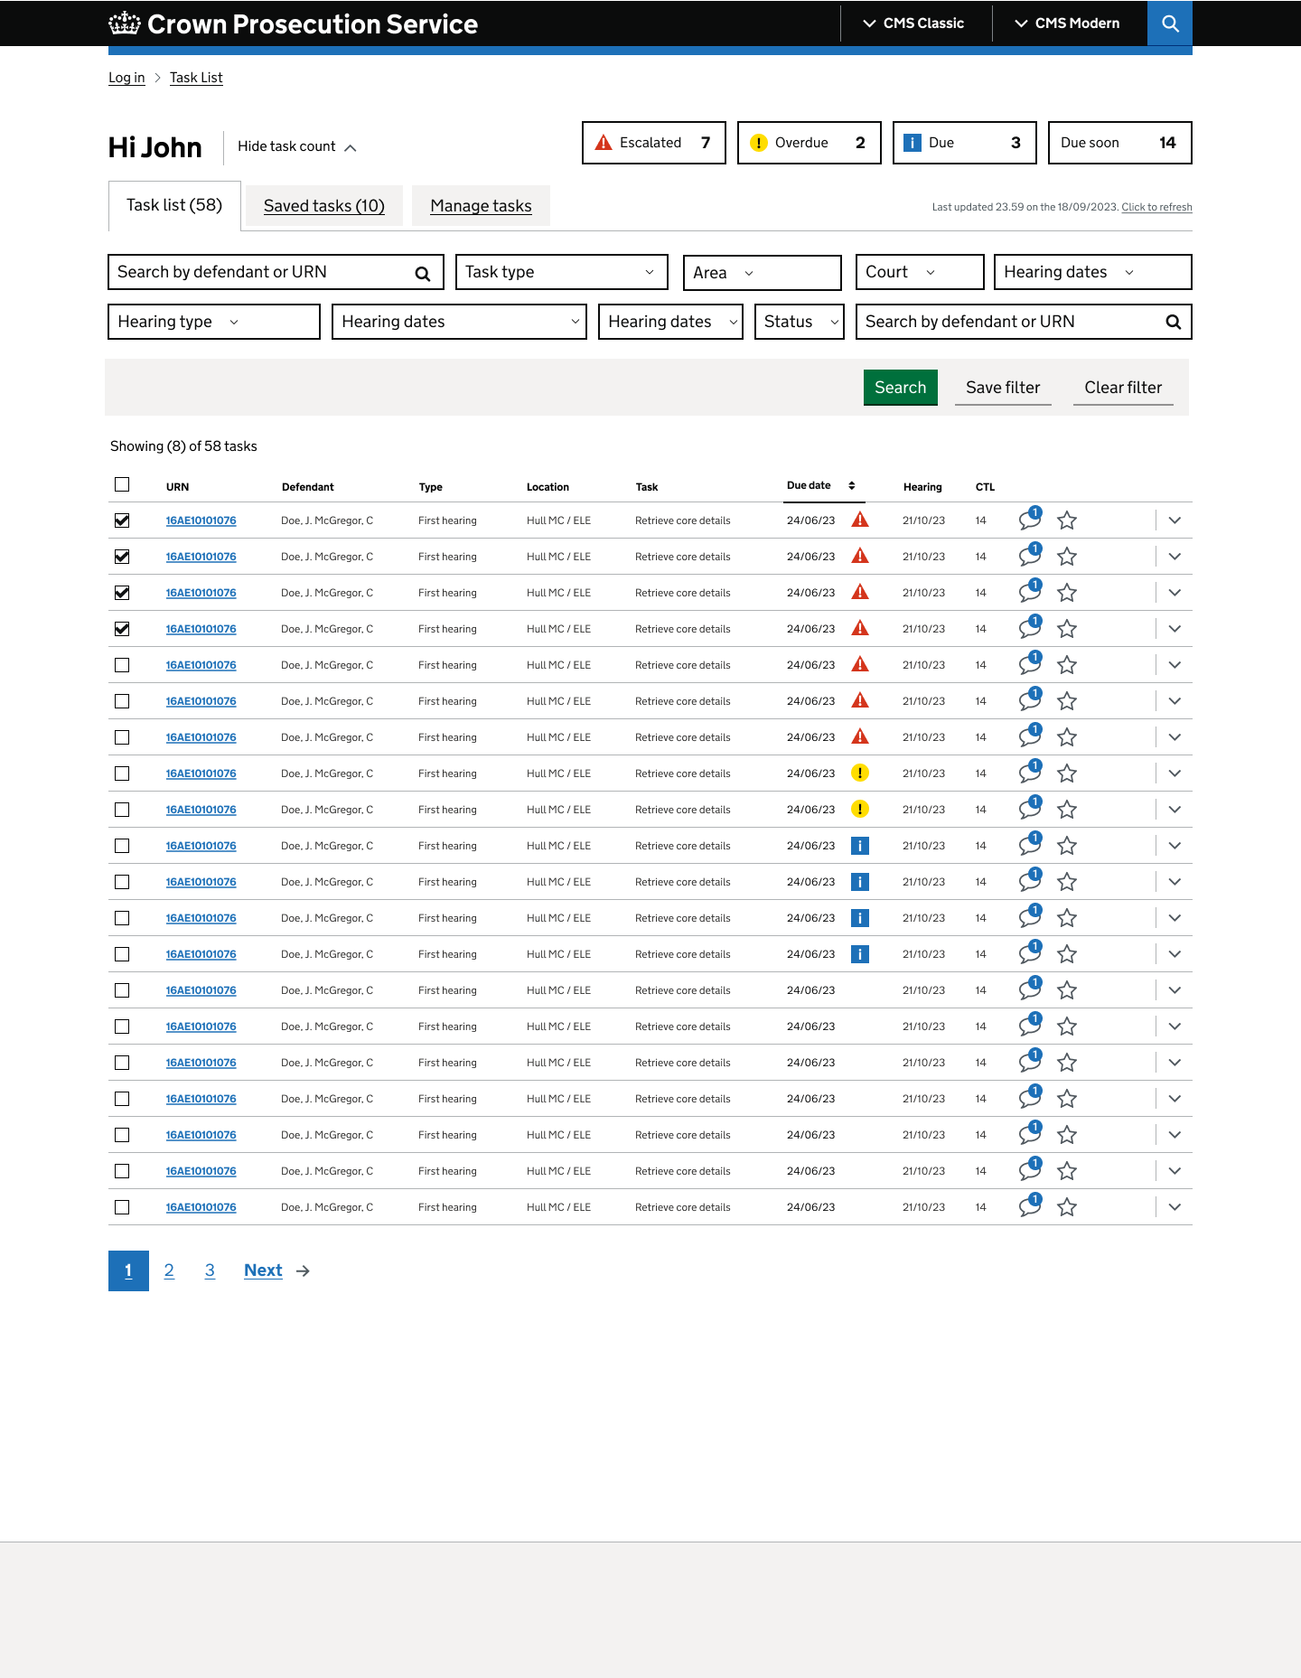
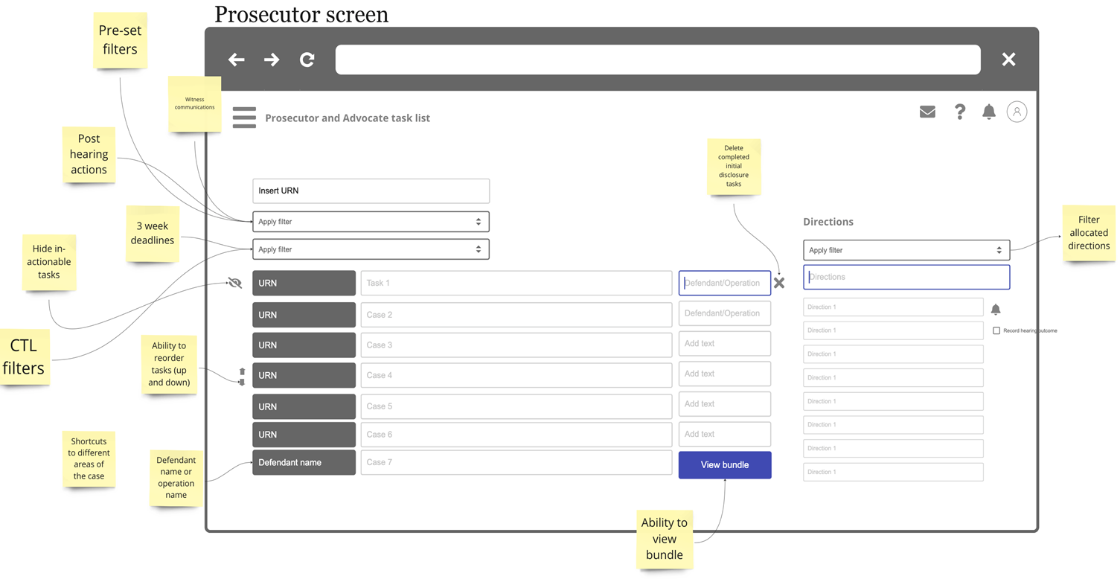
The App has gone through a series of iterations based on feedback from users
We used a functional prototype with dummy data to frequently test designs with users and iterate frequently based on their valuable feedback
1. Current CMS Classic
3. Future Work Management Application
2. Initial Task List mock-up

Slide 9
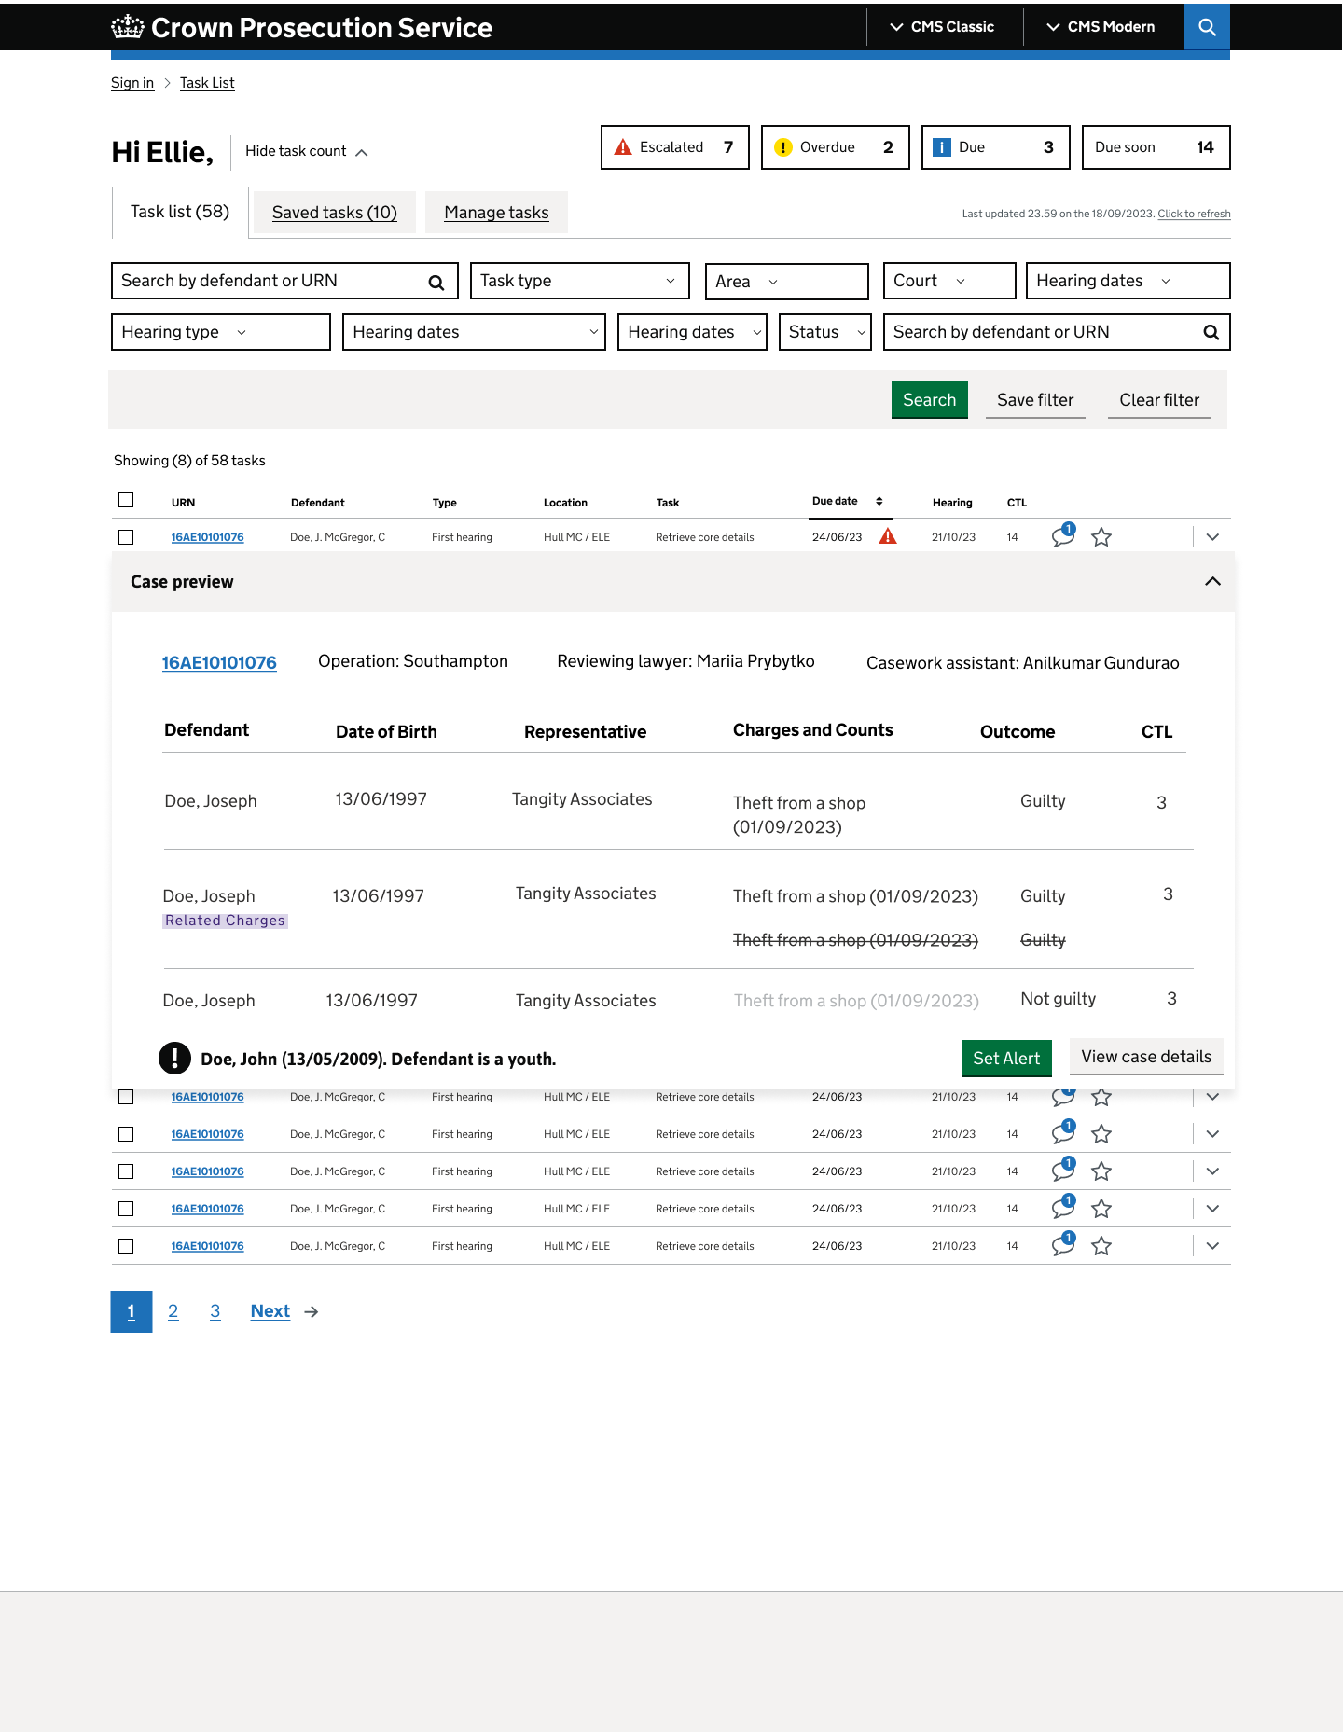
Work Management App features
Task list screen
Task search using URN allows users to search and find all tasks linked to a case to complete them at the same time.
Saved Task tab allows users to save high priority tasks away from the 'sea of red' in the main Task list. Users can save those tasks that are relevant to them (e.g. can exclude error tasks or tasks waiting on others to action) and work through a more manageable, meaningful list.
Case preview provides users with key case information at a glance, making it quicker and easier for them to find important details (without opening a new screen)​. Users can also click directly through to the case in CMS.
Save filter provides users with a way of saving their favourite filter selection combinations, meaning they don’t need to spend time reapplying them as they do today​.

Slide 10
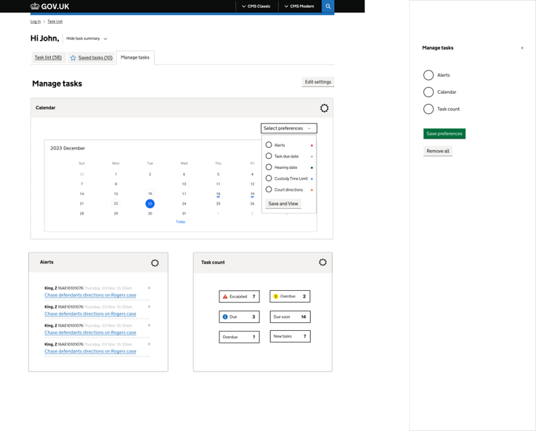
Work Management App features
Manage tasks screen
Calendar gives users the ability to keep tabs on important dates and personalise it according to what’s most important to them.
Task count allows users to view the daily status of their tasks.
Alerts make it easier for users to remember what they need to do next, without clogging up their task list.
Find link to UX report for Alpha in the Index

Slide 11
Beta testing approach
Phase | Users | User profile | Method | Data collection | Notes
Iterative Figma design testing Purpose: Design testing, capturing requirements for any outstanding functionality | Existing 12 Alpha end- users | See next slide | Moderated testing, continue with ad-hoc one to one sessions as per Alpha phase Runs in parallel to UAT testing | Confluence
UAT CIN3/ CIN4 Purpose: test functionality with internal CPS users before releasing into production | Internal users | HQ/DID/ OPTU: Edward Woods, Rosalind Collingwood WM team: BAs, UX Designer, Julie, Nicky, Nicola/Nicola's team Accessibility team's assessment | Users executing pre-defined test scenarios and record bugs and any other feedback Unmoderated Testing against the defined deadlines Focus group for feedback | Confluence/ Jira/ Teams for users to record observations | Define UAT scenarios and required test data
OAT Production Purpose: test functionality with production infrastructure, data and end-users | 5 new end-users from a selected Area | 5 users (one per each role) from Yorkshire & Humberside Area* (mix of Crown and Magistrates Courts): Paralegal Officer - Kirsty Mathers (CC, RASSO, CCU), continuing from Alpha Prosecutor - Lesley Cowling (MC), continuing from Alpha Prosecutor (CC) - to be identified Casework assistant – to be identified Paralegal assistant - to be identified *confirm with the Area that they would be happy to be the first area to roll out and continue engagement after Beta | Users are provided access to environment and asked to use WM app for a period of time for example between 9am – 12pm Focus group for feedback | Dedicated Teams channel where users can post details of any issues found.

Slide 12
2. Solve a whole problem for users

Slide 13






Alignment with in-flight programmes and wider FCT programme objectives
We have established a regular cadence of meetings, both within and across teams, to promote knowledge sharing and alignment
Regular ‘scrum of scrums’
Technical alignment for reusing APIs and integrating with other apps, including Casework app, sMG3, and navigating back to CMS from the WM app
Regular BA alignment calls – Casework app, Case Status BA sync
Regular sharing of insights and progress with Head of User Research (Jake Pywell)
Regular UX designer calls
Working closely with Business Owner (Julie Bowman) on planning and direction setting, as well as alignment with other groups through existing relationships (e.g. ABMs, OPTU … etc.)
We recently also showcased a video to Digital and Major projects illustrate conceptually how a landing page could link all of the applications in development.

Slide 14
3. Provide a joined up experience across all channels

Slide 15
3. Provide a joined up experience across all channels
Question | Answer
Explain the entry points to the service, e.g. how users find or know about it | Users can access the Work Management App through a dedicated sign in page
Explain the data and research being used to improve offline and online channels | n/a - There are currently no online/offline channels
Explain how you’ve explored where the service should start and stop | n/a - Service start and finish is not within the scope of WMA
Explain how you’ve used common components to provide a consistent experience with other CPS services | We are currently using the GDS, Ministry of Justice and Outsystems design systems to design and build WMA, however adjustments have been made to comply with GDS (such as not using the crown emblem and GDS font)
Explain what research has taken place with internal CPS teams who form part of the design of the service, e.g. Wakefield team | During Alpha we conducted 7 rounds of moderated user testing a summary is viewable on page 15
Explain how you might encourage users to use your digital service | We are encouraging users to use the app by providing them with onboarding resources such as an onboarding pack and introductory video
Explain whether there are any gaps, drop off points, re-entry loops, transitions to other channels and returns to the service | We have not designed any transitions to other channels, however there is scope to incorporate WMA in the larger CPS app ecosystem.
Explain how design, user research and content design are considering the full end-to-end service, including the non-digital parts, for example, branding of an email matches that of the service it is sent from | Full end-to-end service design is not within the scope of WMA.

Slide 16
User engagement overview – Alpha
Round | Date (2023) | Engagement type | Testing | New features to test | Sample size
1 | 12 Sept | User testing interview | Task list as-is functionality | n/a | 8 users
2 | 19 Sept | User testing interview | Redesign of task list columns | Defendant as a youth markers Victim under 10 markers Urgent | 8 users
3 | 5 Oct | User testing interview | Urgent tasks Floating action buttons Filtering Comments Expandable menu | Calendars Reminders Task counters | 6 users
4 | 18 Oct | User testing interview | Directions data as-is | n/a | 5 users
5 | 31 Oct | Blue Sky Thinking User & Stakeholder workshop | Idea generation workshop focused on work management for individual and team. | n/a | 6 users
6 | 10 Nov | User testing interview | Directions Filters Widgets Action buttons | Filter tags Weekly round-up of task activity Newly assigned tasks | 7 users
7 | 17 Nov | Accessibility assessment | Jaws, Dragon | n/a | n/a

Slide 17
4. Make the service simple to use

Slide 18
4. Make the service simple to use
Service Designer, Interaction Designer, Content Designer able to:
Question | Answer
Explain how they collected evidence that users of the alpha service are, in the majority of cases, succeeding first time. | Evidence was collected through a series of moderated user testing sessions which will continue to be ongoing throughout private beta and as the WMA app is rolled out to units within CPS.
Explain the service in a simple way to the panel. | Work Management App enables users to view, manage and prioritise their tasks.
Talk through substantial iteration in the design and content of the service during alpha. | There were up to 10 iterations of the Work Management App design that were all tested with users and reviewed by the WMA technical team.
Explain how prototype works as end-to-end user journey for all user needs, including those with assisted digital needs. | The prototype satisfied the user requirements confirmed in the discovery phase. The CPS accessibility team were engaged with during the Alpha phase and recommendations for adjustments are currently being implemented.

Slide 19
5. Make sure everyone can use the service

Slide 20
5. Make sure everyone can use the service
Question | Answer
Explain their plan for increasing digital take up. | Our user engagement plan for Beta phase onwards can be found on the next two slides. Users will also receive an onboarding pack and video to introduce them to WMA.
Explain what other channels the service is delivered through. | n/a - WMA is not currently delivered through other channels
Explain what data they collect on their other channels. | WMA collects data from CMS Classic
Explain which organisations/groups help your user with the existing digital or non-digital services. | n/a
Show customer insight from: research with users, demographics, attitudes, behaviours and channel preferences, and customer journey maps. | Insights/persona mapping can be viewed on page 24 -31
Explain how each channel meets different users’ needs. | WMA requirements were designed around the personas developed as part of the Work Management Discovery – Personas can be found on page 22

Slide 21
Work Management Beta high-level plan
Sprint 8 04/12-22/12 | Sprint 9 02/01-15/01 | Sprint 10 16/01-29/01 | Sprint 11 30/01-12/02 | Sprint 12 13/02-26/02 | Sprint 13 27/02-11/03 | Sprint 14 12/03-25/03 | Sprint 15 26/03-30/03
End Pre-MVP
End MVP
WM App
Iterative requirements to support UX/UI design and continue to build backlog for as-is CMS functionality
Create user engagement / testing approach
Training material for Private Beta
Firm up benefits case
Iterative UX/UI design (Figma)
Develop and harden the code for MVP (DDEI and Outsystems)
Implement redirection with the help of CGI (like Polaris)
Preparation and implementation of infrastructure
for performance testing and production
Performance testing
Deploy Production Infra for ITHC
ITHC
Remedial work from ITHC
Production code deployment
Production infra complete
Add users to Active directory for testing and iterate functionality based on the feedback
Bug fix and harden the infra & code
User engagement
Iterative/ ad-hoc design testing in Figma Users: Existing 12 Alpha end-users
OAT testing in Production for end-users Users: 5 end-users (one per each role) from Yorkshire & Humberside Area
UAT (CIN3/4) for internal users Users: - HQ/DID/ OPTU - WM team - Accessibility team
UX/UI Design
Users & Business
Tech Activities
Set-up and governance
Milestone

Slide 22
Beta testing approach
Phase | Users | User profile | Method | Data collection | Notes
Iterative Figma design testing Purpose: Design testing, capturing requirements for any outstanding functionality | Existing 12 Alpha end- users | Existing 12 Alpha end- users | Moderated testing, continue with ad-hoc one to one sessions as per Alpha phase Runs in parallel to UAT testing | Confluence
UAT CIN3/ CIN4 Purpose: test functionality with internal CPS users before releasing into production | Internal users | HQ/DID/ OPTU: Edward Woods, Rosalind Collingwood WM team: BAs, UX Designer, Julie, Nicky, Nicola/Nicola's team Accessibility team's assessment | Users executing pre-defined test scenarios and record bugs and any other feedback Unmoderated Testing against the defined deadlines Focus group for feedback | Confluence/ Jira/ Teams for users to record observations | Define UAT scenarios and required test data
OAT Production Purpose: test functionality with production infrastructure, data and end-users | 5 new end-users from a selected Area | 5 users (one per each role) from Yorkshire & Humberside Area* (mix of Crown and Magistrates Courts): Paralegal Officer - Kirsty Mathers (CC, RASSO, CCU), continuing from Alpha Prosecutor - Lesley Cowling (MC), continuing from Alpha Prosecutor (CC) - to be identified Casework assistant – to be identified Paralegal assistant - to be identified *confirm with the Area that they would be happy to be the first area to roll out and continue engagement after Beta | Users are provided access to environment and asked to use WM app for a period of time for example between 9am – 12pm Focus group for feedback | Dedicated Teams channel where users can post details of any issues found.

Slide 23

My reality
What doesn’t work well
I find CMS clunky so complete most of my work outside of CMS in Microsoft Word.
I use a paper diary and excel spreadsheet to help prioritise my tasks and because it is hard to know what to prioritise, takes approx. 40 minutes to plan my week.
It's easy to forget about what needs to be done because directions and tasks are in different places on CMS.
I receive emails from my legal manager regarding prioritisation which can impact prioritisation further.
Spend approx. 10 hours waiting for files to load and navigating through files.
The ‘urgent’ red tasks on the task list screen are not always urgent, and urgent tasks are not reflected.
There is no way of viewing urgent tasks.
There is no calendar view and the dates are usually incorrect in CMS.
CMS is full of duplication.
Reviewing evidence is difficult.
I need to look in numerous places for information.
More important tasks are hidden and can be missed.
Ex-employee details appear in lists/filters.
On-screen reminders don't work.
Prosecutor
“Hard to see the wood from the trees when you have a page full of red tasks”
Senior crown prosecutor
(Desk based)
“I've been working with the CPS as a senior crown prosecutor for 5yrs.
In my day-to-day work, I use CMS Classic and CMS Modern for case management.
I spend most of my time reviewing cases on my task list.”
Early Investigative
Advice
Pre-charge
Prior to hearing
What works well
Key requirements
First hearing
I find CMS modern works for searching, document categorisation and re-organising cases.
I find the overview screen in CMS can be useful for some outstanding tasks.
History functionality works well as you can view what someone else has done in a case, which is good, especially for witness care.
I would like a calendar view to be able to see my upcoming trials
A view of the directions and tasks on one screen.
I would like set filters which do not reset.
I would like a better way to review evidence.
I would like to have clearer search signposting.
I would like the DCS system to offer a seamless transition into CMS.
I would like to be able to view Stage 1 and Stage 3's these are most important.
I would like a way to schedule exhibits and witness statements.
The ability to edit (redact) information from documents.
Case preparation
Trial
Sentencing
Stressed
Irritated
Time poor
Overwhelmed
Appeals

Slide 24





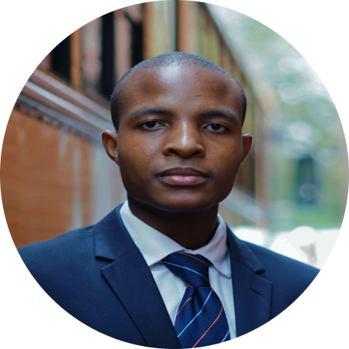
Persona, CMS engagement, CPS process map
Key
This map highlights a personas engagement with CMS along the CPS process and the task management specific relationships.
CMS relationship
Legal Manager
Engagement with CPS process
Advocate
Prosecutor
Operational Delivery Manager
Paralegal Officer and Assistant
Casework assistant
Early Investigative Advice (EIA)
Charge decision
Hearing
Case preparation
Trial
Sentence
Appeals
CPS end-to-end process

Slide 25
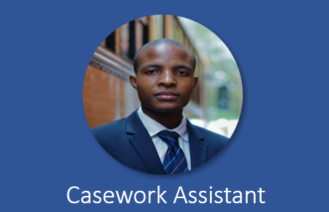
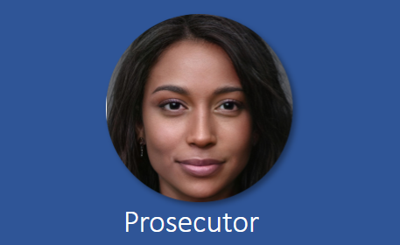
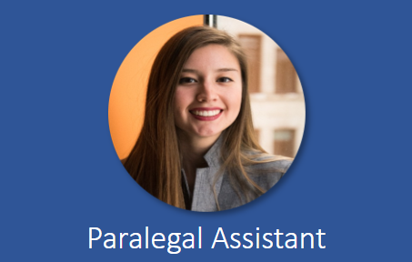
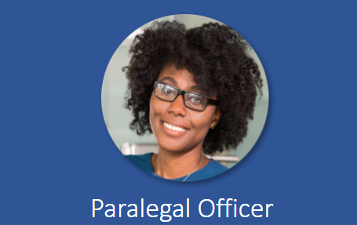

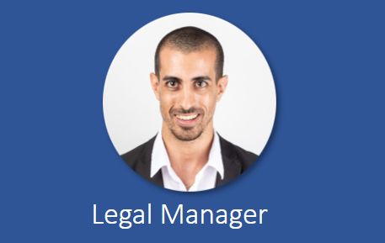
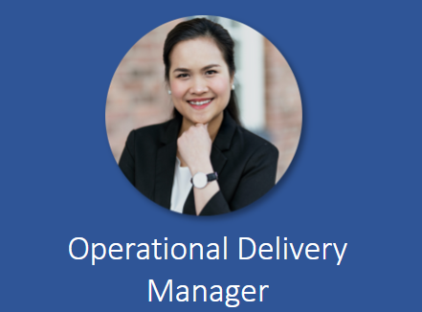

Insights and persona mapping
Showing the relationship between insights and user persona
Users
Managers
Insight | Work Management activity type | Casework Assistant | Prosecutor | Paralegal Assistant | Paralegal Officer | Advocate | Legal Manager | Operational Delivery Manager
Insight 1: The ‘sea of red’ hinders the ability to prioritise and progress casework efficiently | Prioritise
Insight 2: Users don't have the means/tools to organise their tasks in a meaningful way | Prioritise, Manage
Insight 3: It is difficult to find and takes multiple steps to get to the key information | View
Insight 4: Offline tools are used to help planning, prioritising workload and complete tasks | View, Manage, Prioritise
Insight 5: There is no single view of a teams' task activity to be able to plan | View, Manage
Insight 6: The complexity of a case is not clear | Manage
Insight 10: Area performance reporting is time consuming and subject to human error | View, Manage, Prioritise
Persona profiles can be found here.

Slide 26




Casework assistant user journey
CMS classic user journey mapping for common user pain point
Previous
Scenario: Prioritising tasks in the CMS classic task list
Description: A casework assistant would like to prioritise their task list and needs to confirm if any of their new red tasks are youth cases which need to be progressed quicker.
Steps
Step 1
Step 2
Step 3
Step 4
Step 5
Step 6
Step 7
Activity
Login
View task list
Select a new red task from the task list
Select defendant
Prioritise case
Select home screen
Return to Step 2
Insert filters
View defendant
details
Write a note of defendant name on personal notepad
View allocated tasks
Check D.O.B
Experience
Calculate D.O.B
Approx. time to complete: 5 minutes
Technology
CMS Classic
Evaluation
Part of the prioritisation process for Casework Assistants involves understanding which cases must be progressed more quickly than others and a youth case must be progressed.
From the task list a casework is unable to identify a youth case. This process could be simplified by automating the D.O.B and using some form of visual communication to indicate that it needs to be prioritised. This process may have to be completed numerous times for a caseworker to assess how to prioritise their tasks.

Slide 27
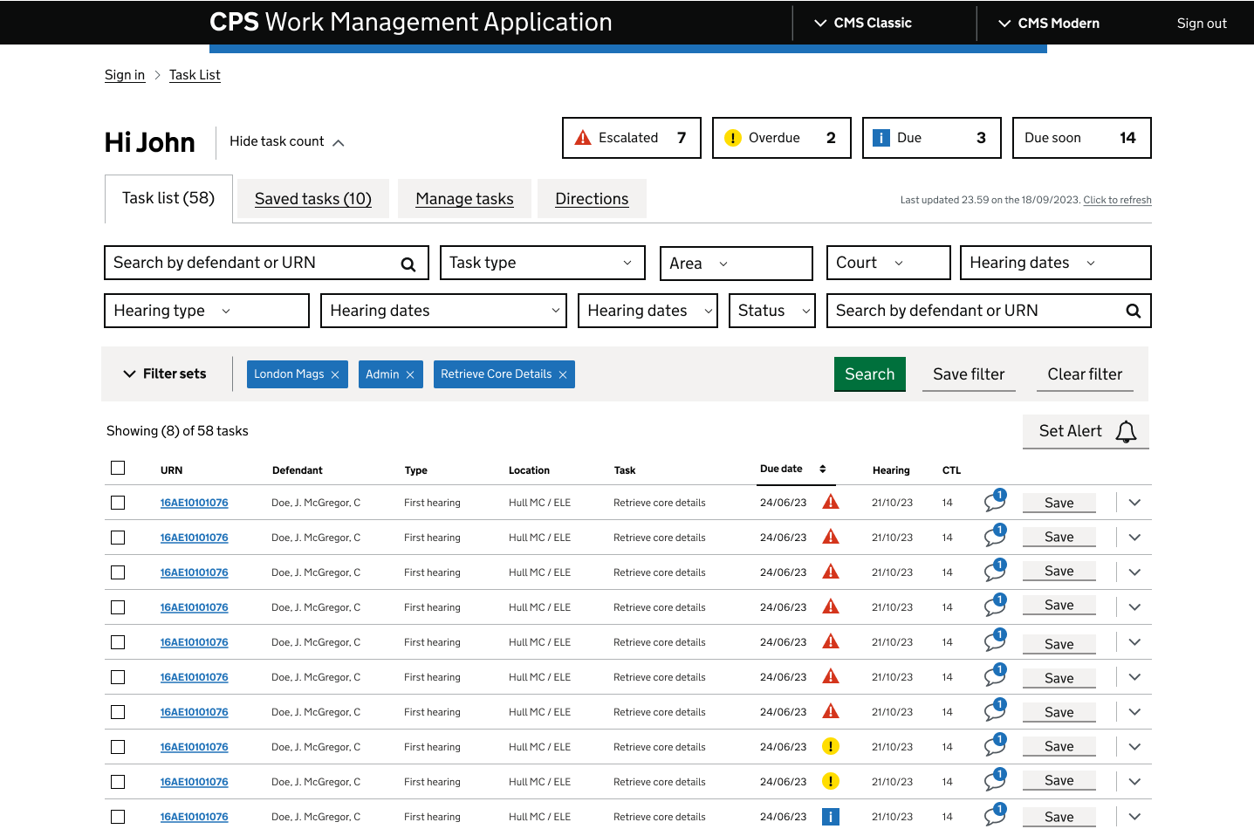
User flow 4
New
Use case
User journey
Requirement 4 "As a User, I want error tasks not to appear on my tasks list to be able to identify and exclude from my task list error tasks that I cannot do anything about."
^{Solution} The option to exclude tasks is not currently available however a Saved Task tab has been designed for users to save high priority tasks away from the main Task list
Start
Sign into WMA
View task list
End
Save task to Saved task list
Select Save
Demo

Slide 28
Thematic analysis of user interviews overview
High level themes, High value moments and Risk themes derived from the affinity mapping analysis using data points from all user interviews
High level themes |  | High value moments |  | Risk
System issues | Notes disappear Unable to sort/filter Unable to reallocate tasks | Visual design | Colour coding Flagging to signify urgency to others | Time/delays | ½hr chasing information 3hrs waiting for service desk
Manual workarounds/ off-system | Use of Excel, Word, Teams Users use paper diaries Removing geo tags | Due dates/calendar | Prioritising according to due dates Works 2 weeks in advance | System performance issues | CMS crashing during court presentation 15% of tasks are dispatch errors
Time/delays | PTPH is a lengthy process Multiple screens to locate info No logic to document management | CMS Modern | Good for searching Collapsible folders Good for categorising | Training/guidance | Potential security breaches if information sent to the wrong lawyer
User Experience issues | Hard to find documents Red tasks are not always urgent | Collaboration | Allocation sheets from manager | User experience | CMS classic doesn’t give a true representation of case
Collaboration | Comments aren’t comprehensive DCF/Service desk | User experience | Registering, updating, finalizing, easy to delete files | Manual work arounds/off system | Excel, Word, Teams Resolving bundle errors
Help/guidance/training | Avoiding complex cases Some use Modern and some don’t |  |  | Morale | 80% of tasks completed by due date More important tasks further down the list
Morale | Lack of trust for CMS classic Feeling managed by CMS classic
Lack of information/visibility | No calendar view to see deadlines No consolidated view of tasks
Visual design | No preview Hard to view what tasks to prioritise

Slide 29
Categorisation of work management most painful pain points from workshops
Categories | Pain points
Clicking through multiple steps/screens to find the relevant information to help prioritise tasks | Clicking through multiple screens to prioritise work - e.g. charges screen to see if it's magistrates / full code / EIA
 | Viewing tasks - A lot of switching between Classic/Modern - awkward
 | Need to check D.O.B on youth cases - these are not immediately clear. Need to add monitoring code to a case and put youth (regularly come across/irritating)
 | Using multiple screens on one device to complete a task
 | Information dispersed in different places that could be shown in single view - e.g. tasks and directions
 | Tasks not always appearing on task list
 | Need to click through multiple screens to locate information - e.g digging deeper into witness care comms to get full context
 | Searching is difficult, especially with large volumes of evidence (only have CTRL+F)
Capability to re-organise or re-assign tasks according to the users' individual requirements | Flexibility /functionality to organise / sort tasks based on knowledge and experience (e.g. removing errors / duplicate tasks / on hold tasks)
 | Lack of flexibility around task categorisation - Proceeds of Crime tagging everything under reminder tasks
 | 30-35% of tasks in task list cannot be acted upon
 | Manually delete the bundle file error tasks - doesn't automatically clear - clogs task list
 | Initial disclosure tasks clog up task list - Frustrating because it reappears, it shouldn't be on there.
 | Lack of flexibility around rectifying mistakes - e.g. once case finalised can not delete directions (process issue as managers can do this)
Data does not represent real-life | Due date doesn't reflect urgency of task - prioritise by hearing date for example or urgent comms

Slide 30
Research synthesis process – High level themes > Observations > Insights > Master themes
The process of synthesizing the data from interviews to achieve the master themes of the user research
High level themes from interviews
System performance issues
Manual workarounds/ off-system
Time/delays
User Experience issues
Collaboration
Help/guidance
Morale
Observations from interviewer
The 'sea of red' is a profound problem for Casework Assistants, Prosecutors, Operational Delivery Managers and Legal Managers teams. It effects their ability to prioritise effectively. ​
For Prosecutors and Advocates, who are less ‘task’ orientated, the CMS is much less fit for purpose – diaries were a common theme in terms of how they plan their week and know what they need to be doing. These users spend significant amounts of time trying to find information and generally lack trust in the tool.
For Managers, upwards reporting is very difficult – it’s manual, time-intensive and subject to error using numerous spreadsheets to tell the ‘true’ picture of their team’s workload because they cannot get that from CMS. Allocating tasks is also difficult as managers don’t have a single view of their teams workload and complexity of cases is not immediately obvious.
For Paralegals and Clerking teams, the CMS just about does what it needs to do, albeit with some well-known challenges and use of offline tools.
Insights
The ‘sea of red’ hinders the ability to prioritise and progress casework efficiently ​
Users don't have the means/tools to organise their tasks in a meaningful way​
It is difficult to find and takes multiple steps to get to the key information ​
Offline tools are used to help planning, prioritising workload and complete tasks​
There is no single view of a teams' task activity to be able to plan ​
The complexity of a case is not clear ​
Switching between different tools causes frustration​
Users don't have adequate training, onboarding and CMS guidance​
Document management is time consuming​
Reporting is time consuming and subject to human error​
Error handling delays case progression​
CMS performance issues negatively impacts Work Management ​
Offline calendars are used to help task allocation
Master themes
​ 1. Data visualisation requirements​ ​
​ 2. Streamlining work management processes​ ​
​ 3. Self-management tools​ ​
​ 4. User experience challenges​ ​
​ 5. Technical issues​ ​

Slide 31
Insights to master themes classification synthesis
The user interviews uncovered thirteen insights which were classified into master themes
Insights | Classifications
Insight 1: The ‘sea of red’ hinders the ability to prioritise and progress casework efficiently | Filtering, self-management, sorting, data, visual design
Insight 2: Users don't have the means/tools to organise their tasks in a meaningful way | Self-management, filtering, data, technical issues
Insight 3: It is difficult to find and takes multiple steps to get to the key information | Information, visibility, searchability, technical issues, data, visualisation, visual design,
Insight 4: Offline tools are used to help planning, prioritising workload and complete tasks | Work management processes, streamlining, off system tools, data
Insight 5: There is no single view of a teams' task activity to be able to plan | Information, visibility, technical issues searchability, data, visualisation, visual design,
Insight 6: The complexity of a case is not clear | Information, visualisation, visual design, data, user experience, self-management, visibility
Insight 7: Switching between different tools causes frustration | User experience, workflow, streamlining
Insight 8: Users don't have adequate training, onboarding and CMS guidance | Streamlining processes, guidance, support, self-management, user experience
Insight 9: Document management is time consuming | User experience, workflow, filtering, sorting, streamlining process
Insight 10: Reporting is time consuming and subject to human error | Data, information, visualisation, user experience, technical issues
Insight 11: Error handling delays case progression | User experience, self-management, technical issues, user experience
Insight 12: CMS performance issues negatively impacts Work Management | Technical issues, user experience
Insight 13: Offline calendars are used to help task allocation | Work management processes, streamlining, off system tools, data
Master themes
1. Data visualisation requirements
2. Streamlining work management processes
3. Self-management tools
4. User experience challenges
5. Technical issues

Slide 32
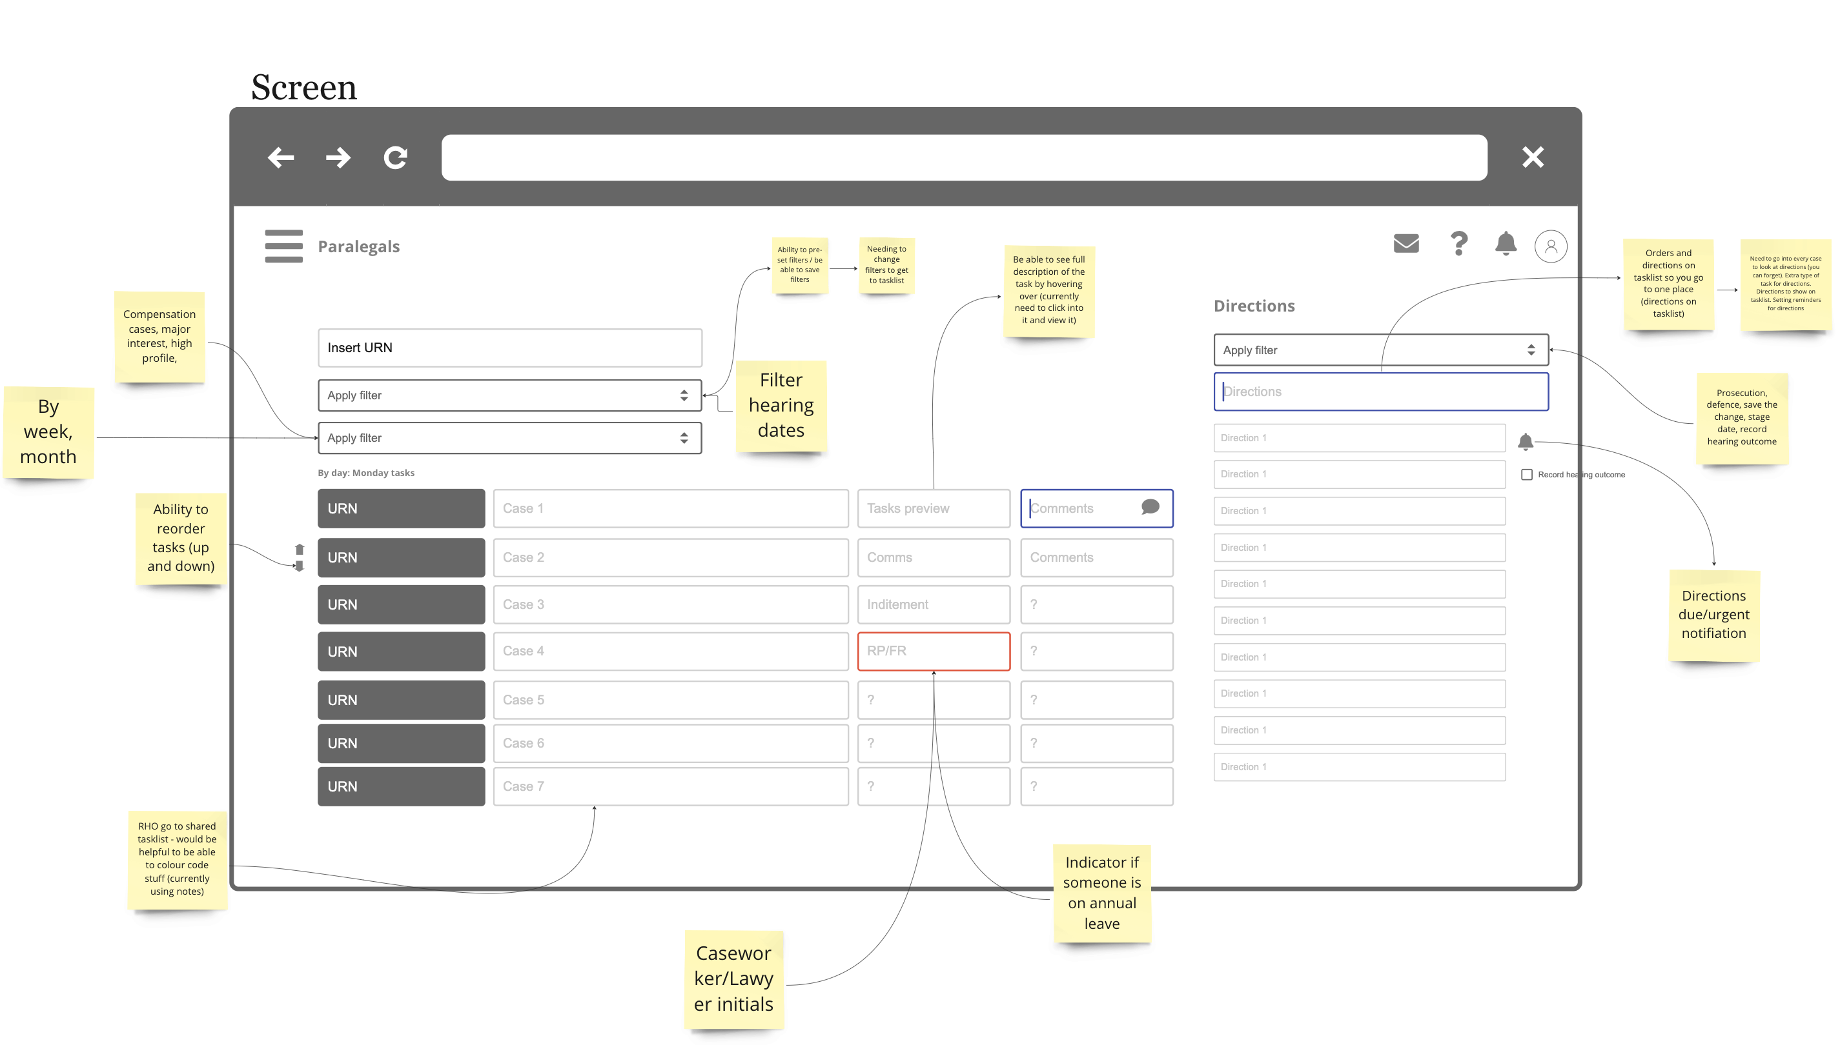
Workshop 2, Activity 3: Paralegal officers and assistants interface mock-up
Low-fidelity interface mock-up
Paralegal requirements
Filters | Week, Month Compensation cases Major Interest, high profile Hearing dates Directions – Prosecutor name
Visibility | Caseworker/lawyer initials Comments from Manager Orders & Directions
Icons, markers | Show who is on annual leave Directions due date
Visual design | Each caseworker has a colour for their tasks, to see who has been allocated which tasks
General functionality | Pre-set filters Record hearing outcome Ability to re-order the tasks in the list

Slide 33
6. Have a multidisciplinary team

Slide 34
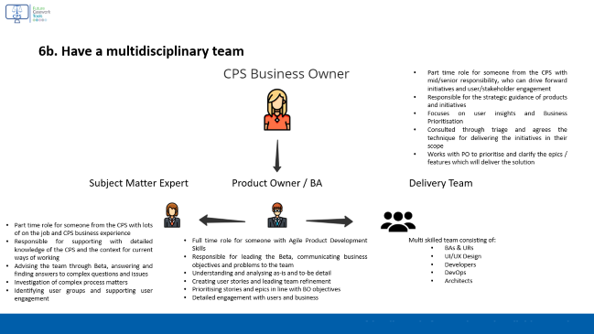
6. Have a multidisciplinary team
The Work Management Delivery Team is comprised of both full-time and part-time resource, drawing upon experience from the CPS domain and industry alike.
Key resources including our Solution Architect, Business Owners, and OutSystems team are cross-cutting i.e. they work across more than one Replacing CMS workstream.
Where we need oversight, support, or expertise from beyond our team, we have been able to identify these individuals and work closely with other CPS teams.
Some of the traditional GDS roles you may expect to see, such as the Product Manager, are a combination of individuals; this combines product and domain knowledge.
Our Business Analysts, Designer, Architect, and Business Owners have been part of the team since the Discovery Phase, which has provided a strong understanding of the problem space which we have been able to leverage to support our Full Stack and OutSystems Devs to ensure we build the right service.
Work Management Delivery Team
Email Automation
Nicky Freeman
Business Owner
Anilkumar Gundurao
Solution Architect
Zalika King
UX/UI Designer
Amar Mani
Cloud DevOps
Simona Andersson*
Business Analyst
Robert Wright
Full Stack Dev
Joao Pereira
OutSystems Lead
Replacing CMS
Julie Bowman
Business Owner
Kirsty Priest*
Business Analyst & SME
Angus Beare
Full Stack Dev
Mariia Prybytko
OutSystems Dev
Work Management Reports
Callum Clark
Business Analyst
Carl Hall
Delivery Lead
Desiree Dias
OutSystems Dev
Arpit Desai
Power BI / Data Vis
*Kirsty has joined the team and will be replacing Simona in Feb ‘24

Slide 35

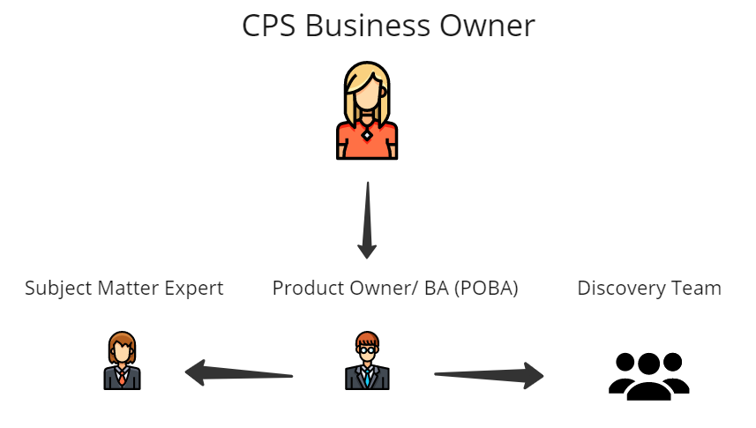
6b. Have a multidisciplinary team
Part time role for someone from the CPS with mid/senior responsibility, who can drive forward initiatives and user/stakeholder engagement
Responsible for the strategic guidance of products and initiatives
Focuses on user insights and Business Prioritisation
Consulted through triage and agrees the technique for delivering the initiatives in their scope
Works with PO to prioritise and clarify the epics / features which will deliver the solution
Subject Matter Expert Product Owner / BA Delivery Team
Part time role for someone from the CPS with lots of on the job and CPS business experience
Responsible for supporting with detailed knowledge of the CPS and the context for current ways of working
Advising the team through Beta, answering and finding answers to complex questions and issues
Investigation of complex process matters
Identifying user groups and supporting user engagement
Full time role for someone with Agile Product Development Skills
Responsible for leading the Beta, communicating business objectives and problems to the team
Understanding and analysing as-is and to-be detail
Creating user stories and leading team refinement
Prioritising stories and epics in line with BO objectives
Detailed engagement with users and business
Multi skilled team consisting of:
BAs & URs
UI/UX Design
Developers
DevOps
Architects

Slide 36
7. Use agile ways of working

Slide 37
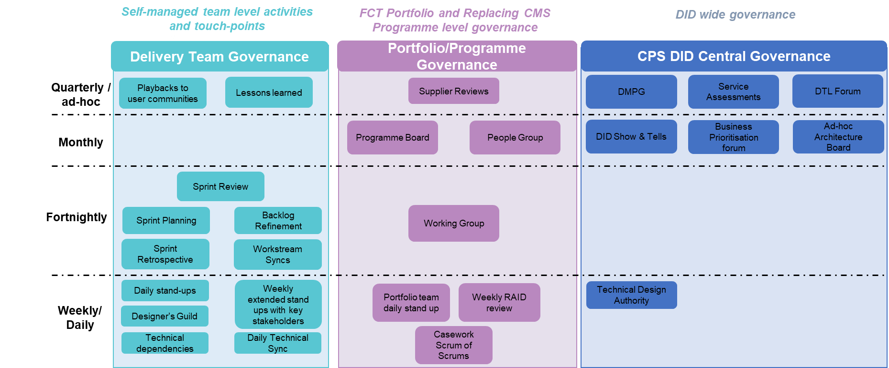
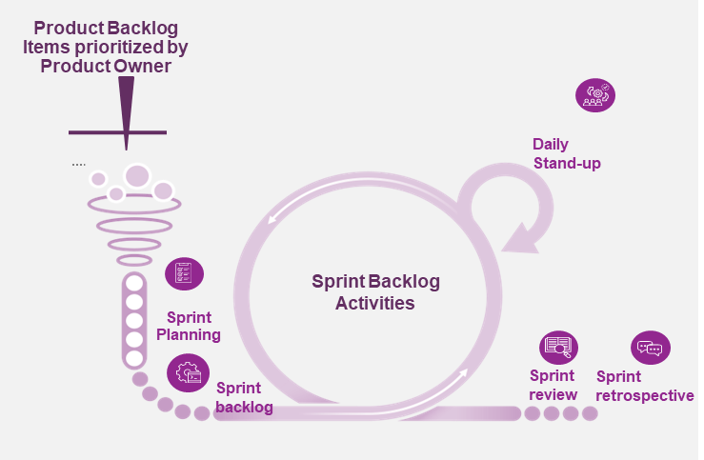
7. Use agile ways of working
The team operate in a two-week cadence, supported by a number of agile ceremonies.
At the end of Discovery, we identified fourteen High-Level Requirements, against which we developed a number of user stories.
Throughout Alpha, we frequently refined our backlog and prioritised with oversight from our Business Owners to ensure we tackle the most important problems first.
Typically, each sprint we engage with users to understand their needs, design and prototype solutions, and test these designs with users to ensure the service is what they need.
Throughout the Alpha, we maintained a network of users from several roles, units, and areas to ensure the solution caters for the varied ways that colleagues do their job.
Our Ways of Working and Governance

Slide 38
8. Iterated and improved frequently

Slide 39
8. Iterated and improved frequently
Throughout the Alpha stage we built a prototype with mock data in addition to a functional proof of concept connected to the CMS Test environment.
Building and maintaining these separate instances of the Application eliminated the dependency between our front-end and back-end development and meant that we could spend more time proving our riskiest assumptions.
Designing, building, and testing with users frequently has enabled us to ensure that when we commit to back-end development, we have a good understanding of what we need to achieve.
Most of our stories follow a similar pattern:
We identify the need with user research.
We mature the need into a user story with a structured requirement, whilst understanding the as-is process, and defining our functional and non-functional acceptance criteria.
We complete an initial design in Figma, using GDS assets, and often design multiple options which we then test with users.
We build the design in the prototype with mock data.
We build the API, test, and refine if needed.
Develop the back-end API for the selected solution
User Research
User Stories
Initial Design
Prototype Build
Functional Build
Design & test solutions to meet the needs (Figma)
Build & test solutions with mock data (OutSystems)
Understanding user’s needs
Requirements definition & as-is analysis (Jira)

Slide 40
9. Create a secure service which protects users’ privacy

Slide 41





9. Create a secure service which protects users’ privacy
Data Protection: we have completed an Initial Screening question set, and the DPIA has now progressed to a Stage 1 LE assessment. This has been reviewed with input from Cyber and the Head of DPCT; we are currently updating against the comments received prior to submission for formal sign off by the DPO.
Protection: access to users as part of beta will be intentionally restricted. We will ensure that access to the app will require the following 3 criteria: CMS access, Active Directory access, and part of the role defined by work management app. Additionally, we have restricted the IP range to only the IPs emerging from CPS.
Security anti-personas / bad actors: a range of these have been explored for the service:
Users who do not have CMS logins
Users who do not have an Azure Active Directory login
Users who do not have access to work management app
Users who are trying to access the app IP address from outside of the CPS network
Cookies: no new cookies have been introduced in our app – the CMS cookie has been reused.
Tech choices and common components: we selected technologies which are already in use within the CPS estate, including OutSystems for the front-end build, an extension of the .NET services on Azure for the DDEI APIs, and AWS.
Risks: to mitigate the potential for data to leave the CPS network, we have planned to conduct a ITHC / Penetration Test. Establishing a secure VPN tunnel between Azure and AWS ensures that data remains secured whilst in transit.

Slide 42
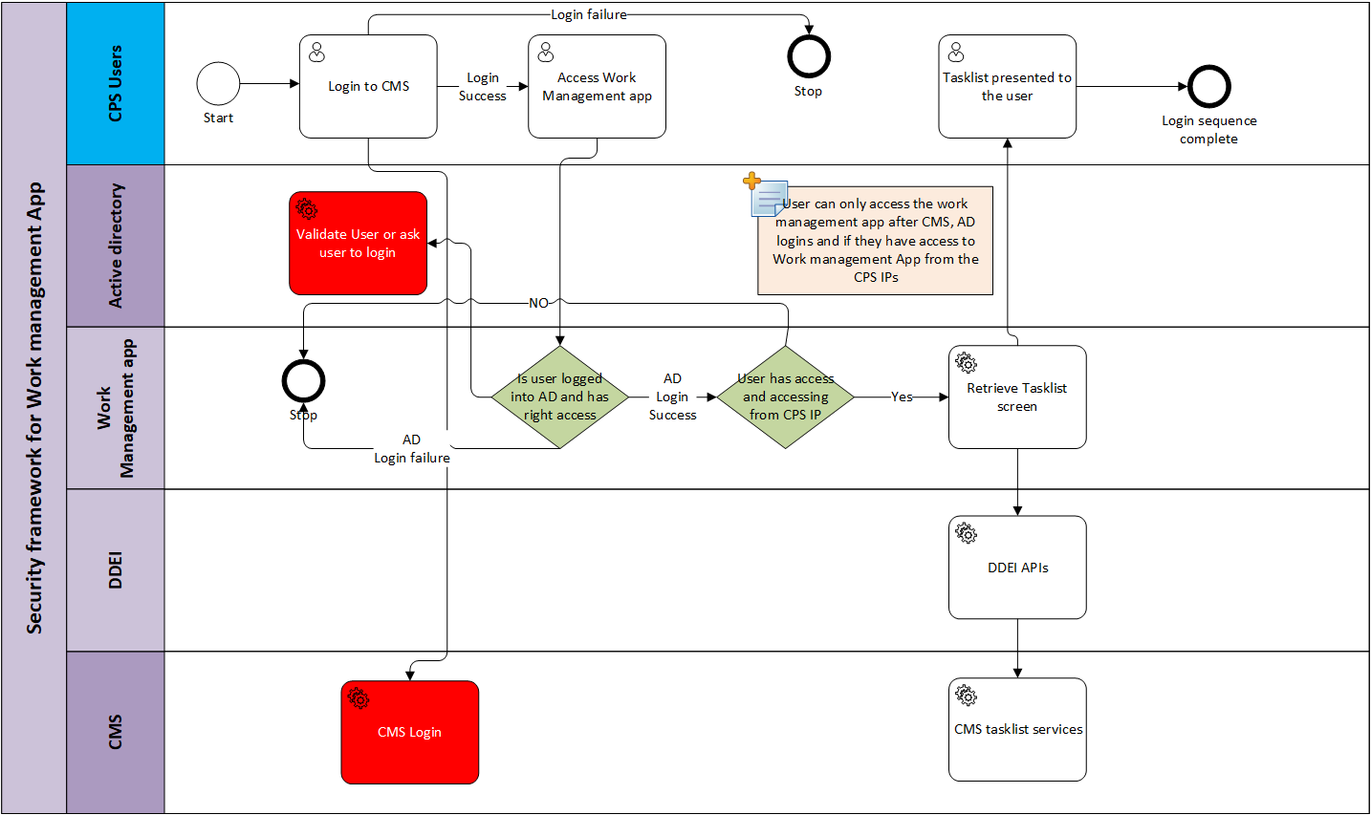
Security – Login process for work management app
ITHC scope for work management app - ITHC for work management App - Future Casework Tools - Confluence (atlassian.net)

Slide 43
10. Define what success looks like and publish performance data

Slide 44
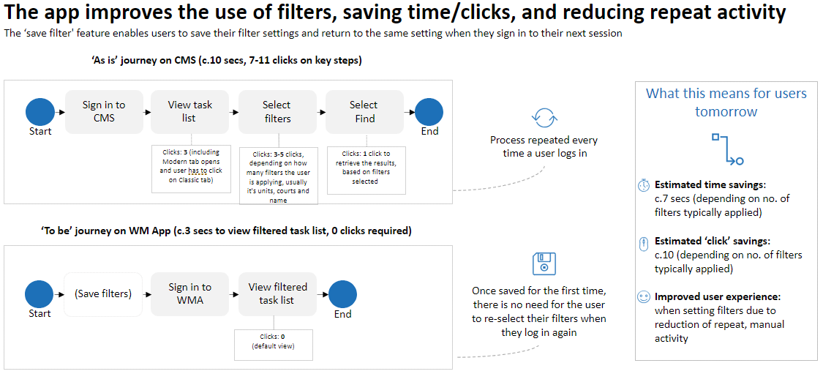
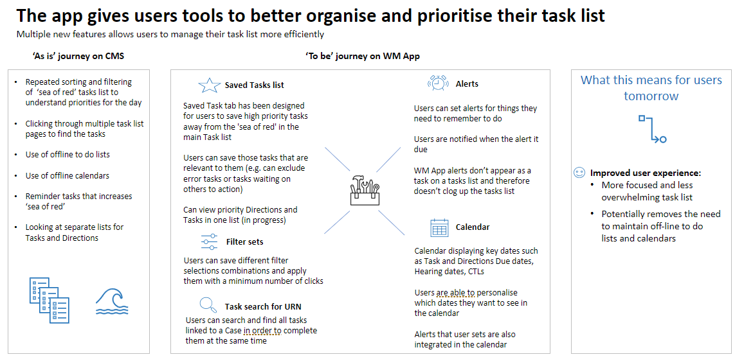
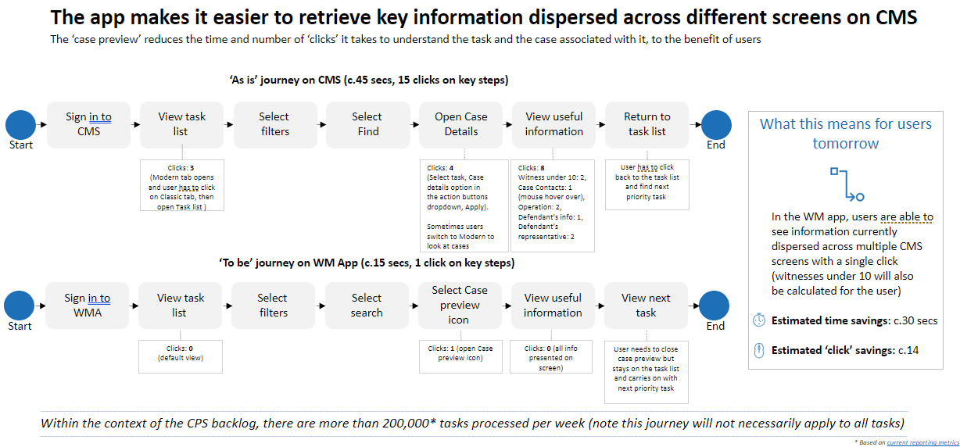



Work Management App helps users to better view, manage and prioritise their task list
We compared key user journeys that user takes in CMS and WM App to assess whether our solution delivers benefits to the users
What this means for users tomorrow*
Based on interviews with the end-users, we have identified three key metrics that the new solution would need to be assessed against to determine if it is delivering benefit to the users.
Time savings
Reduction in clicks
Improved user experience
*Benefits will be re-assessed during Beta phase

Slide 45

01
“As a User, I want to see useful information when determining task priority, so that I can quickly identify my priorities in the task list"
The App makes it easier to retrieve key information dispersed across various CMS screens
The ‘case preview’ reduces the time and number of ‘clicks’ it takes to understand the task and the case associated with it, to the benefit of users
‘As is’ journey on CMS (c.45 secs, 15 clicks on key steps)
Sign in to CMS
View task list
Select filters
Select Find
Open Case Details
View useful information
Return to task list
What this means for users tomorrow*
Start
End
Clicks: 3
(Modern tab opens and user has to click on Classic tab, then open Task list )
Clicks: 4
(Select task, Case details option in the action buttons dropdown, Apply).
Sometimes users switch to Modern to look at cases
Clicks: 8
Witness under 10: 2, Case Contacts: 1 (mouse hover over), Operation: 2, Defendant’s info: 1, Defendant’s representative: 2
User has to click back to the task list and find next priority task
In the WM app, users are able to see information currently dispersed across multiple CMS screens with a single click (witnesses under 10 will also be calculated for the user)
Estimated time savings: c.30 secs
Estimated ‘click’ savings: c.14
‘To be’ journey on WM App (c.15 secs, 1 click on key steps)
Sign in to WMA
View task list
Select filters
Select Search
Select Case preview icon
View useful information
View next task
Start
End
Clicks: 0
(default view)
Clicks: 1 (open Case preview icon)
Clicks: 0 (all info presented on screen)
User needs to close case preview but stays on the task list and carries on with next priority task
*Benefits will be re-assessed during Beta phase
Within the context of the CPS backlog, there are more than 200,000* tasks processed per week (note this journey will not necessarily apply to all tasks)
* Based on current reporting metrics

Slide 46


06
"As a User, I want my task view filters and sort to persist, so that I don't need to set them every time I open my task list."
The App improves the use of filters, saving time/clicks, and reducing repeat activity
The ‘save filter' feature enables users to save their filter settings and return to the same setting when they sign in to their next session
‘As is’ journey on CMS (c.10 secs, 7-11 clicks on key steps)
What this means for users tomorrow*
Sign in to CMS
View task list
Select filters
Select Find
Start
End
Process repeated every
time a user logs in
Clicks: 3 (including Modern tab opens and user has to click on Classic tab)
Clicks: 3-5 clicks, depending on how many filters the user is applying, usually it's units, courts and name
Clicks: 1 click to retrieve the results, based on filters selected
Estimated time savings: c.7 secs (depending on no. of filters typically applied)
Estimated ‘click’ savings: c.10 (depending on no. of filters typically applied)
Improved user experience: when setting filters due to reduction of repeat, manual activity
‘To be’ journey on WM App (c.3 secs to view filtered task list, 0 clicks required)
(Save filters)
Sign in to WMA
View filtered task list
Once saved for the first time, there is no need for the user to re-select their filters when they log in again
Start
End
Clicks: 0
(default view)
*Benefits will be re-assessed during Beta phase

Slide 47







05
"As a User, I want to be able to organise my task view, so that I can have a view that is relevant to me."
The App gives users tools to better organise and prioritise their task list
Multiple new features allows users to manage their task list more efficiently
‘As is’ journey on CMS
‘To be’ journey on WM App
Repeated sorting and filtering of ‘sea of red’ tasks list to understand priorities for the day
Clicking through multiple task list pages to find the tasks
Use of offline to do lists
Use of offline calendars
Reminder tasks that increases ‘sea of red’
Looking at separate lists for Tasks and Directions
Saved Tasks list
Alerts
What this means for users tomorrow*
Saved Task tab has been designed for users to save high priority tasks away from the 'sea of red' in the main Task list
Users can save those tasks that are relevant to them (e.g. can exclude error tasks or tasks waiting on others to action)
Can view priority Directions and Tasks in one list (in progress)
Users can set alerts for things they need to remember to do
Users are notified when the alert it due
WM App alerts don’t appear as a task on a tasks list and therefore doesn’t clog up the tasks list
Improved user experience:
More focused and less overwhelming task list
Potentially removes the need to maintain off-line to do lists and calendars
Calendar
Filter sets
Users can save different filter selections combinations and apply them with a minimum number of clicks
Calendar displaying key dates such as Task and Directions Due dates, Hearing dates, CTLs
Users are able to personalise which dates they want to see in the calendar
Alerts that user sets are also integrated in the calendar
Task search for URN
Users can search and find all tasks linked to a Case in order to complete them at the same time
*Benefits will be re-assessed during Beta phase

Slide 48
11. Choose the right tools and technology

Slide 49
11. Choose the right tools and technology
Explain that architectural artefacts, decisions and plans have been documented, shared across your community and reviewed and assured.
All of the artefacts related to architecture/design are in sharepoint or in Confluence. TDA decisions and plans related to Work management App are in Sharepoint and we are using JIRA to assess progress against the plan. We are complaint to the guardrails and principles of CPS.
Explain the tools the team will be using and why they are value for money.
All of the tools are reused (Outsystems for UI and Azure APIs for DDEI APIs) and were presented / approved by the TDA, and are already in use by CPS.
Explain any constraints with Legislation, contracts or technology that may have an impact on the service.
All the technical options used are already used in CPS.
Explain how you’re aligning technology choices with the recommended tech stack used across CPS, where possible.
All the tech stack is already being used within CPS and no new IT stack has been introduced.
Explain that a working prototype/technical spikes/or proof of concept has been built and tested to prove that the architecture is fit for purpose.
All of the Prototypes were validated and were tested against the requirement.
Explain if/that the team will continue to re-evaluate and challenge previous decisions as new requirements are discovered.
Yes, we have reevaluated the requirements for e.g. case status discovery output against some of the requirements in work management app.
Notes:
https://cps-innovation.github.io/digital-sop/standards/archtecture/

Slide 50
12. Make new source code open

Slide 51
12. Make new source code open
Explain your plan for making all new source code open and reusable.
All of the code written for work management app are in Outsystems or in .net in Azure env.
Explain how a team in another department could reuse the code.
All the APIs written in DDEI are 100% reusable for e.g. ListDirections is already being reused as part of case status and work management report. The code written in Outsystems are reusable depending on the use cases.
Link to high level solution design in confluence - High level design - Work Management Application - Future Casework Tools - Confluence (atlassian.net)
DDEI APIS in confluence - DDEI API's - FCT2.0 - Confluence (atlassian.net)
Performance test strategy for Beta - Performance test strategy for MVP - Future Casework Tools - Confluence (atlassian.net) – This is only for Beta as we work through to get access to the CGI performance test env.

Slide 52


User research
Business viability
Technical feasibility
Solution 2: Data visualisation and taskable dashboard (PoC view)
Alpha and Proof of Concept, Summary of Scope
User interface Aligned to GDS Standards
Work
Management
PoC Scope
Quick Actions (PoC Scope)
Work Management quick action buttons can be used to manage tasks. These buttons, (which include, for example, the ability to defer or reassign tasks) are part of existing CMS functionality available today and will be replicated in solution 2. The full list of these action buttons, and their scope in relation to work management, will be further explored in the alpha phase.
_{Handoff to the existing UIs}
SMG3
Data Visualisation
(Manager)
User Task List
Polaris UI
Implement the DDEI which will interact with CMS server-side and screens. DDEI working with the CMS task model making it easier for users to prioritise and complete actions. This solution will use the data lake to get the Dashboard data
CMS Modern UI
Active Directory
_{Read-only}
_{dashboards}
_{Quick Action buttons}
CMS Classic UI
_{Data Lake}
Capability | Tools
Data visualisation | PowerBI
User interface | OutSystems UI
Data Store / Data Lake | Azure Data Lake
Reusable Callouts to update CMS
DDEI
CMS Server-side services
Reuse of CMS server-side to read-write data into CMS DB
CMS Task model used to drive the business workflow
Continues to use the CMS Database
CMS database
Solution 2 is the TDA approved solution which includes the Data visualisation read-only dashboard using PowerBI for managers and new UI using OutSystems.

Slide 53
13. Use and contribute to open standards, common components and patterns

Slide 54
13. Use and contribute to open standards, common components and patterns
Architect, Developers, Service Manager, Content, Interaction, Service Design able to
Question | Answer
Explain how the service has used the GOV.UK design patterns, front-end tool kit and GDS style guide during alpha. | We are currently using the GDS and OutSystems design systems to design and build WMA, however adjustments have been made to comply with GDS (such as not using the crown emblem and GDS font).
Explain what design, content design and front-end developer support was available to the team during alpha. | The UX designs received support from the CPS design guild which meets weekly to discuss design fundamentals, UX and UI.
Explain how the team is avoiding locking themselves into any proprietary solutions where an open standard is available. | OutSystems developed code can be extracted as #.net code. This can then be ported to whichever the platform that gets chosen in future.
Describe what common platforms have been identified that their intended system could use. | OutSystems is already being used across CPS areas including public facing
Describe any common user needs identified and how they are going to be addressed in a consistent manner with the rest of government. | All non-work management related insights were triaged to the relevant teams as recorded on page 51

Slide 55
Non-work management related user insights
Not all 13 identified insights fall under Work Management scope, we will take Work Management insights and will do further exploration for solutions, solutions feasibility assessment and prototyping. Non-Work Management insights will be passed to the relevant teams within CPS
Insight | Work Management activity type​ | Why it is not a Work Management insight? | Handover to | Comments
Insight 7: Switching between different tools causes frustration | Non-Work Management | Context switching between different tools doesn’t directly impact prioritisation needs. | Business and Ops workstream​ | Currently there is no solution identified to tackle this issue. Recently a tech spike was proposed to investigate how to integrate various interfaces, and this is under investigation.​
Insight 8: Users don't have adequate training, onboarding and CMS guidance | Non-Work Management | Training need aspect has been captured across other WM Insights that are in scope. | Learning and Development and Ops Directorate​ | Due to users reporting various training related issues the Discovery team will feed back the pain points etc identified to the COTTS (training team) to establish approach to bridge the gaps​ Onboarding processes and training provisions during this period might benefit from a review as users report issues with using CMS which could be resolved with training. ​
Insight 9: Document management is time consuming | Non-Work Management | Document management pain points often relate to large cases and this will be addressed by another Discovery. | Business and Ops workstream​ | Pain points surrounding document management processes within CMS will be added onto Business and Ops workstream backlog.​ Large cases are likely going to be investigated by Off-CMS Large Cases Discovery ​
Insight 11: Error handling delays case progression | Non-Work Management | The way errors are handled (user errors, system errors) is not directly linked to Work Management. | Business and Ops workstream​ | Further analysis to avoid errors will be added to Business and Ops backlog and brought into other work​
Insight 12: CMS performance issues negatively impacts Work Management | Non-Work Management | There are known issues with CMS, most of which could be addressed by solutions that are not Work Management focused. | Business and Ops workstream/ other​ | This insight captures an array of issues, some of which are being separately investigated by other teams/projects, some will be added to Business and Ops backlog.​
Insight 13: Offline calendars are used to help task allocation | Non-Work Management | Diary and calendars management is not being considered for Work Management needs. | Business and Ops workstream​ | Pain points surrounding diary management and visibility of people’s availability can be added to Business and Ops backlog.​

Slide 56
14. Operate a reliable service

Slide 57
14. Operate a reliable service
Although the Work Management Application will not be a mission critical system in the immediate future, we do need to understand how reliable the service is for users.
We have developed a performance testing strategy to better understand the load that the application will place on the legacy CMS system and infrastructure.
Work Management solution has three main components:
The app in OutSystems (AWS Cloud),
The DDEI functions (Azure Microsoft Cloud),
The CMS (On-premise).
They are deployed in three different environments and network bandwidth and latency might be an issue. As part of deploying the MVP to Production, it would be ideal to test each component for scalability. This will provide a more measured understanding of how the new and the old components would perform under volume/load testing.
Albeit, in the event of either a planned or unplanned outage of the Work Management Application / OutSystems platform in which it is hosted, users will be able to revert to their current ways of working in the Classic and Modern CMS.
We plan on further engaging CGI (once we have resolved some current commercial blockers) to more formally understand how we may utilise the CMS load/performance environments (hosted outside of the CPS network) to support additional reliability testing.
Shorter term support for the Application will be via the current Delivery Team, but we will need to address how the service can be effectively handed over and supported by the service manager teams.

Slide 58
Thank you

Slide 59
Index
Links to key deliverables
Deliverable | Link
Work Management Application Prototype | Click here
Technical Design Authority (TDA) Presentation | Click here
Jira Backlog (User Stories) | Click here
User Experience Report | Click here
Blue Sky Thinking Report | Click here
Figma (Application Design) | Click here
Work Management Report Requirements | Click here

